Slide 1
PRESENTAZIONE PROGETTO BUSINESS INTELLIGENCE
DAVIDE ZANGARI 844760 GIUGNO 2022

Slide 2
1. SOMMARIO
Titoli affini selezionati:
The Coca-Cola Company (KO) e Mc Donald's (MCD)
Alphabet (GOOG) e Amazon (AMZN)
Tesla (TSLA) e Ford (F)

Slide 3
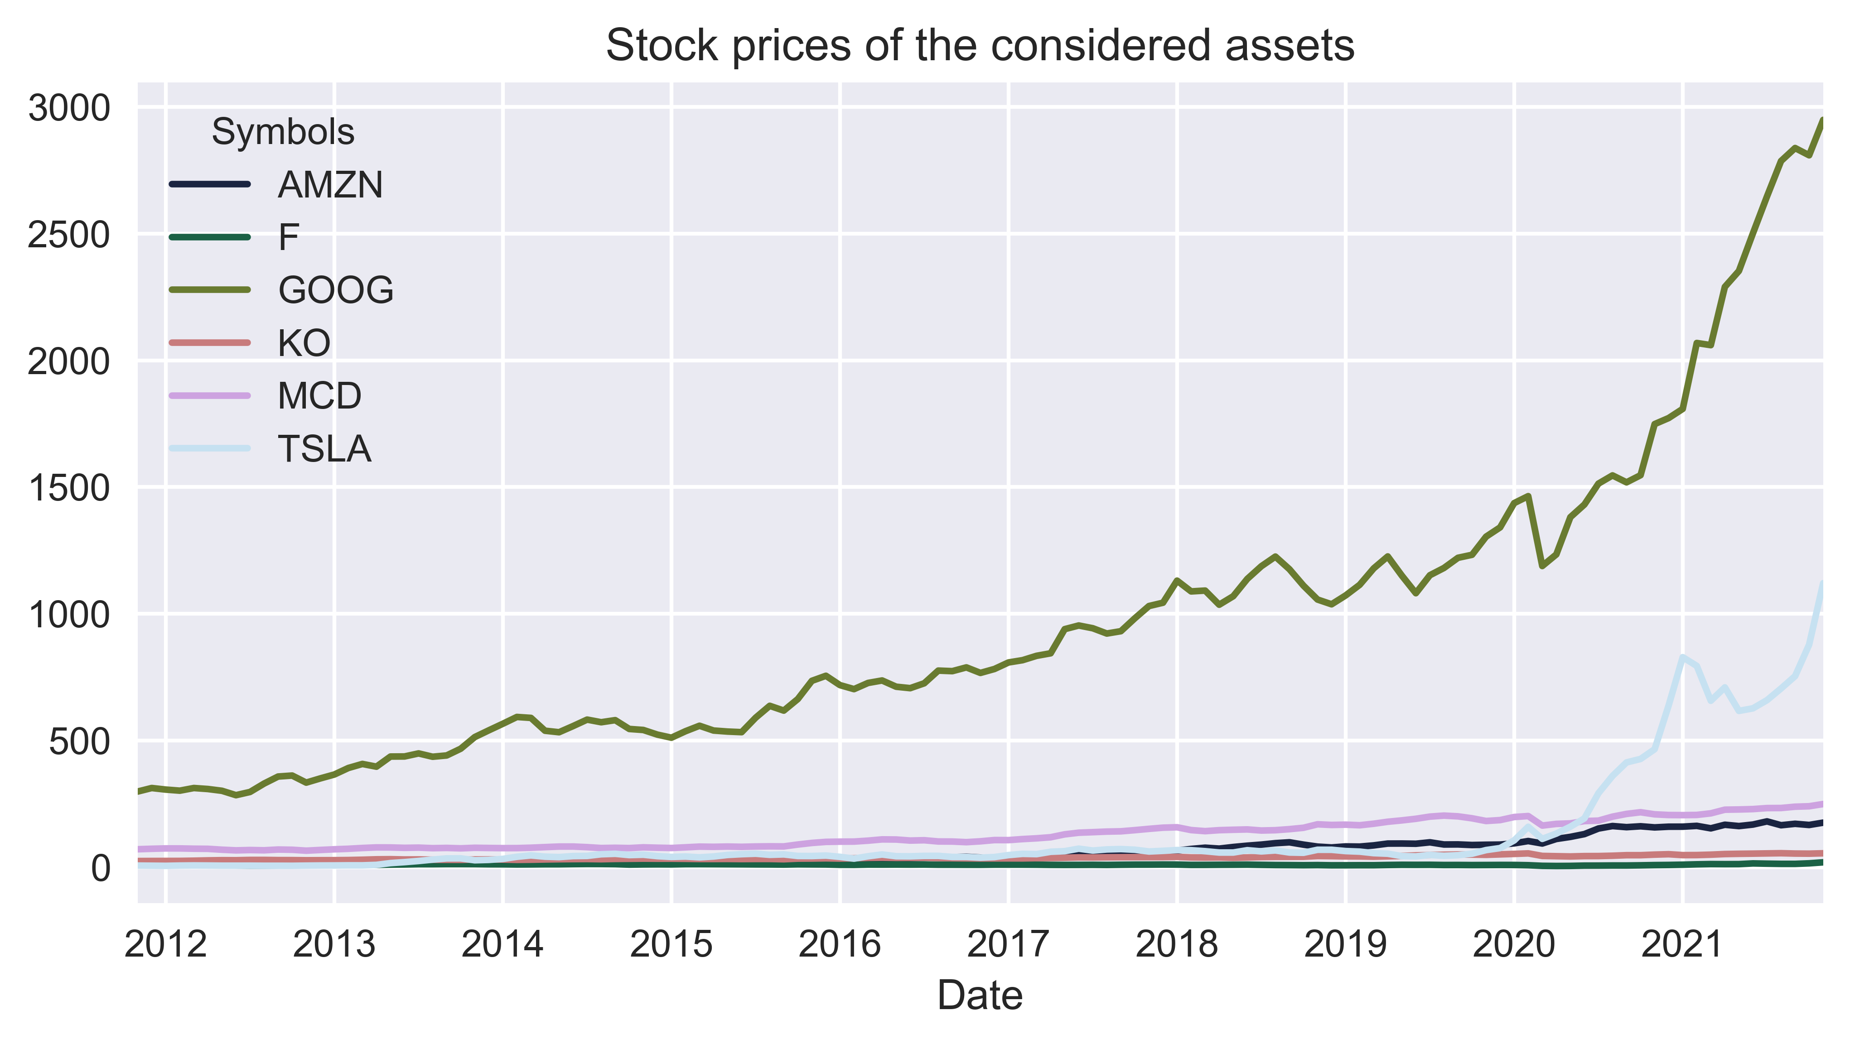
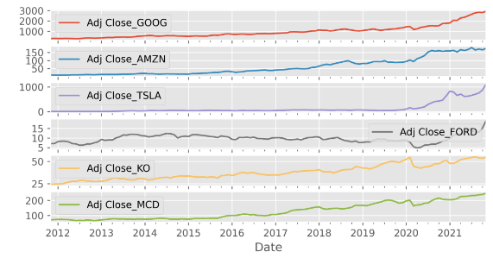
Dati scaricati da Yahoo-Finance! Periodo di riferimento 30/11/2011 - 30/11/2021 con sensibilità mensile

Slide 4
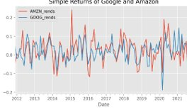
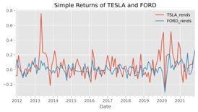
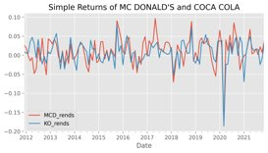
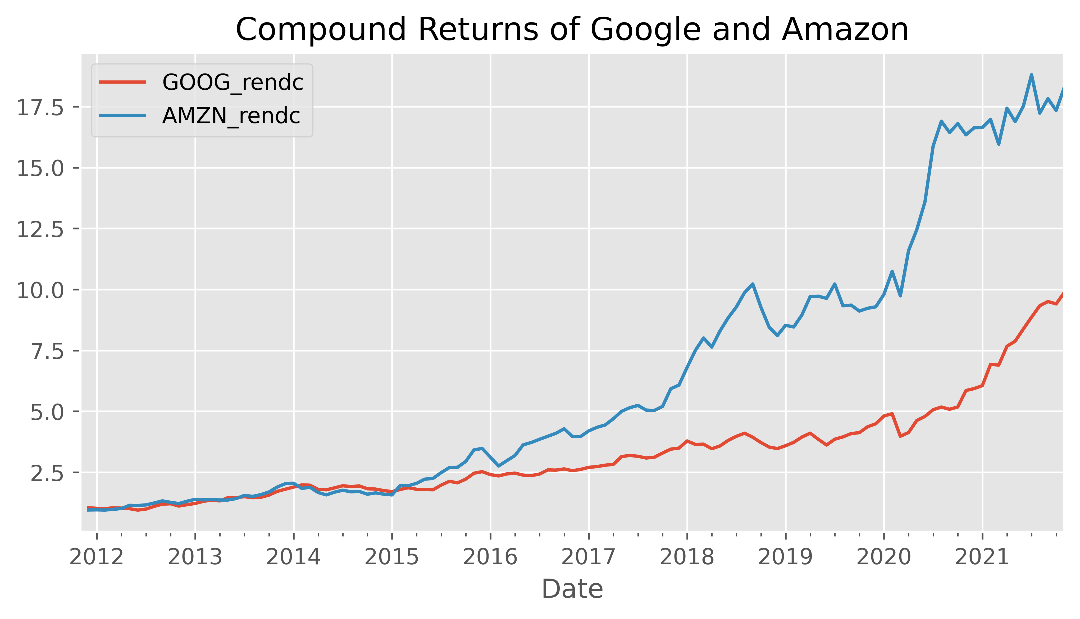
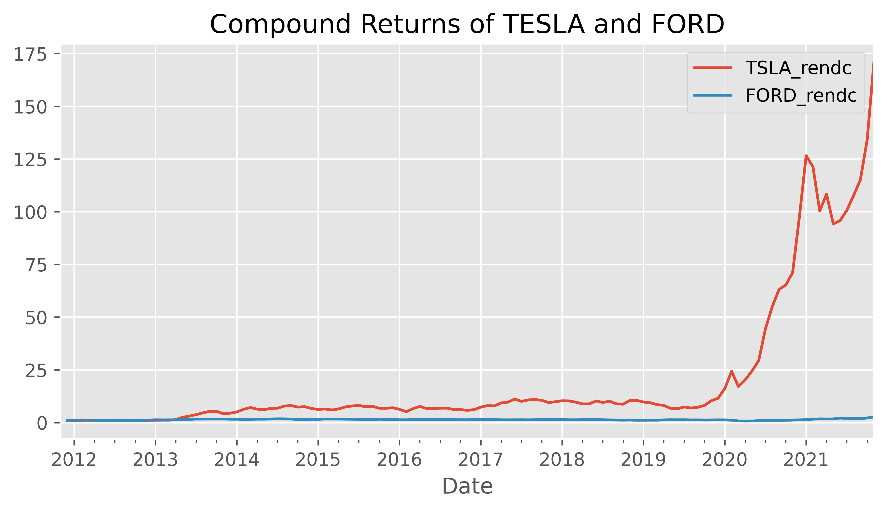
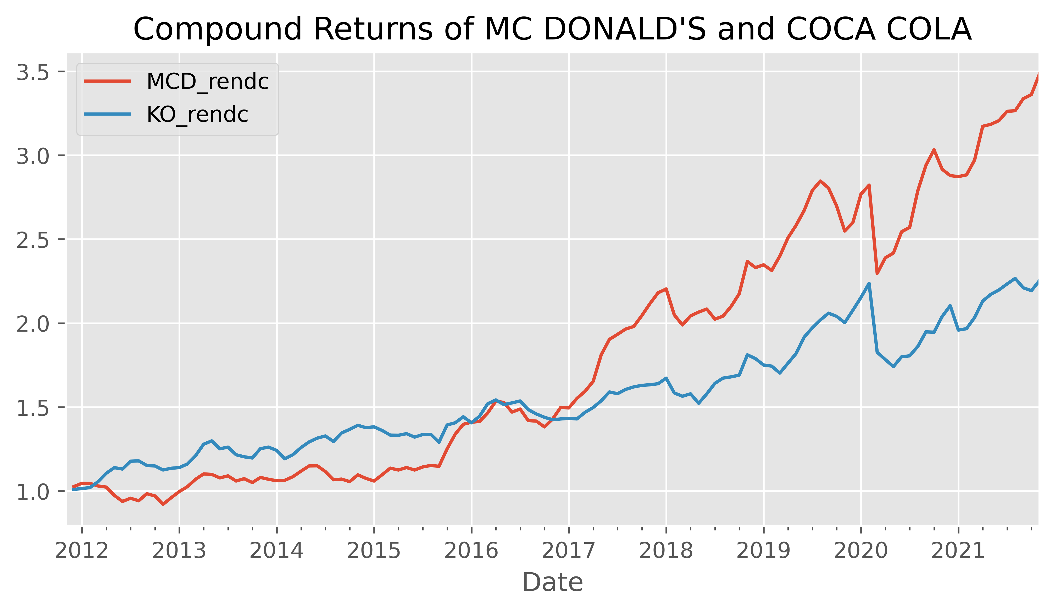
2. STATISTICHE

Slide 5
STATISTICHE MCD
 | High | Low | Open | Close | Volume | Adj Close
count | 121.000000 | 121.000000 | 121.000000 | 121.000000 | 1.210000e+02 | 121.000000
mean | 144.684062 | 142.675426 | 143.677597 | 143.697154 | 4.631379e+06 | 128.589223
std | 50.179555 | 49.288162 | 49.755260 | 49.729584 | 1.533751e+06 | 54.497594
min | 86.418571 | 85.433333 | 85.932857 | 85.910476 | 2.055000e+06 | 65.876457
25% | 98.023000 | 96.920909 | 97.507273 | 97.599091 | 3.378747e+06 | 77.652379
50% | 123.458001 | 122.050500 | 122.795500 | 122.804500 | 4.416414e+06 | 107.199322
75% | 185.027143 | 182.360001 | 183.539524 | 183.952381 | 5.642386e+06 | 171.650019
max | 253.555238 | 250.181428 | 251.909047 | 252.036667 | 8.615884e+06 | 249.324341

Slide 6
STATISTICHE KO
 | High | Low | Open | Close | Volume | Adj Close
count | 121.000000 | 121.000000 | 121.000000 | 121.000000 | 1.210000e+02 | 121.000000
mean | 44.690754 | 44.112078 | 44.403978 | 44.403696 | 1.430425e+07 | 37.880017
std | 5.734220 | 5.632338 | 5.687728 | 5.678745 | 3.472158e+06 | 8.225129
min | 33.980000 | 33.360001 | 33.669998 | 33.615002 | 8.743718e+06 | 24.388361
25% | 40.829500 | 40.311429 | 40.548182 | 40.572273 | 1.206785e+07 | 31.524616
50% | 43.439474 | 42.894211 | 43.113000 | 43.206316 | 1.365984e+07 | 36.520461
75% | 47.520526 | 46.901579 | 47.209473 | 47.219524 | 1.578355e+07 | 43.621318
max | 59.192106 | 58.301053 | 58.793158 | 58.652632 | 3.151999e+07 | 55.278075

Slide 7
STATISTICHE AMZN
 | High | Low | Open | Close | Volume | Adj Close
count | 121.000000 | 121.000000 | 121.000000 | 121.000000 | 1.210000e+02 | 121.000000
mean | 61.061170 | 59.745754 | 60.438129 | 60.419474 | 8.235998e+07 | 60.419474
std | 52.569330 | 51.386456 | 51.999889 | 51.972118 | 2.590800e+07 | 51.972118
min | 9.251275 | 9.005150 | 9.124450 | 9.162150 | 3.979445e+07 | 9.162150
25% | 16.446783 | 16.073044 | 16.263370 | 16.298718 | 6.510500e+07 | 16.298718
50% | 39.654738 | 39.124786 | 39.320405 | 39.448262 | 7.552453e+07 | 39.448262
75% | 90.615975 | 88.911705 | 89.981543 | 89.680137 | 9.081050e+07 | 89.680137
max | 182.370858 | 178.751403 | 180.635571 | 180.800310 | 1.629607e+08 | 180.800310

Slide 8
STATISTICHE GOOGLE
 | High | Low | Open | Close | Volume | Adj Close
count | 121.000000 | 121.000000 | 121.000000 | 121.000000 | 1.210000e+02 | 121.000000
mean | 968.111583 | 950.648403 | 959.237279 | 959.746671 | 2.436360e+06 | 959.746671
std | 612.146657 | 600.964060 | 606.101386 | 606.807757 | 1.478561e+06 | 606.807757
min | 286.525792 | 281.694618 | 284.581889 | 284.246951 | 8.461636e+05 | 284.246951
25% | 540.111910 | 530.943141 | 535.470502 | 536.519088 | 1.471091e+06 | 536.519088
50% | 787.089620 | 776.667524 | 782.312863 | 782.171422 | 1.756755e+06 | 782.171422
75% | 1192.324407 | 1167.521519 | 1181.301819 | 1180.686812 | 3.055692e+06 | 1180.686812
max | 2979.854736 | 2927.673340 | 2957.534889 | 2948.650484 | 7.391863e+06 | 2948.650484

Slide 9
STATISTICHE TSLA
 | High | Low | Open | Close | Volume | Adj Close
count | 121.000000 | 121.000000 | 121.000000 | 121.000000 | 1.210000e+02 | 121.000000
mean | 134.120560 | 128.451358 | 131.319651 | 131.480338 | 3.464398e+07 | 131.480338
std | 228.056464 | 218.178105 | 223.121363 | 223.545809 | 2.201112e+07 | 223.545809
min | 5.654100 | 5.391900 | 5.551200 | 5.498000 | 3.801500e+06 | 5.498000
25% | 40.595429 | 39.149238 | 39.780000 | 39.934857 | 2.135475e+07 | 39.934857
50% | 49.882000 | 47.747239 | 48.756667 | 48.910095 | 3.077647e+07 | 48.910095
75% | 68.568285 | 66.777900 | 67.761400 | 67.716666 | 4.477868e+07 | 67.716666
max | 1148.589042 | 1086.110000 | 1117.766666 | 1120.662383 | 1.243649e+08 | 1120.662383

Slide 10
STATISTICHE F
 | High | Low | Open | Close | Volume | Adj Close
count | 121.000000 | 121.000000 | 121.000000 | 121.000000 | 1.210000e+02 | 121.000000
mean | 12.285013 | 12.020679 | 12.160592 | 12.154848 | 4.548378e+07 | 9.733807
std | 2.994027 | 2.962552 | 2.980071 | 2.980416 | 1.954555e+07 | 2.100576
min | 5.093810 | 4.820476 | 4.979048 | 4.921905 | 2.004023e+07 | 4.839994
25% | 10.216818 | 9.995455 | 10.101818 | 10.084091 | 3.297226e+07 | 8.429635
50% | 12.310435 | 12.097727 | 12.241304 | 12.202273 | 3.973994e+07 | 9.739790
75% | 14.550000 | 14.329000 | 14.438500 | 14.425500 | 5.107249e+07 | 10.824468
max | 19.840953 | 19.063333 | 19.478571 | 19.527619 | 1.192198e+08 | 19.240008

Slide 11
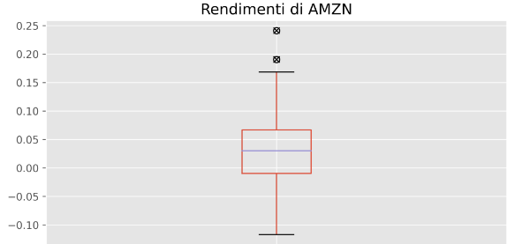
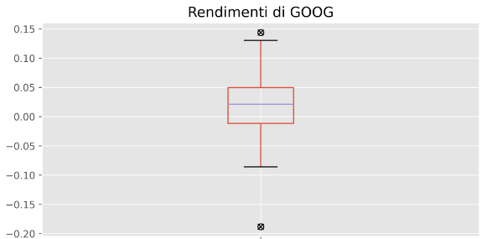
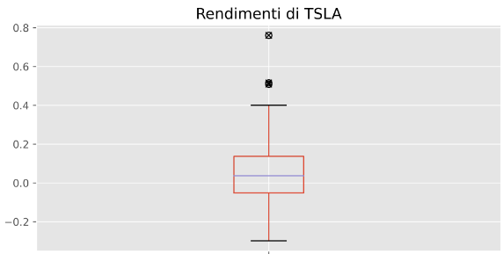
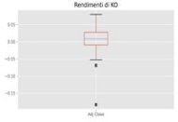
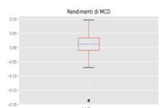
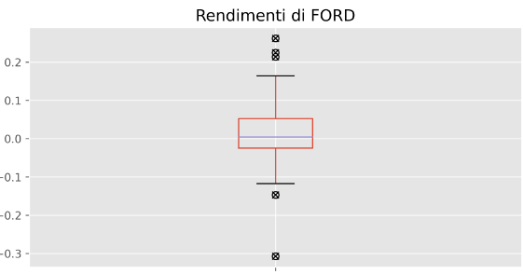
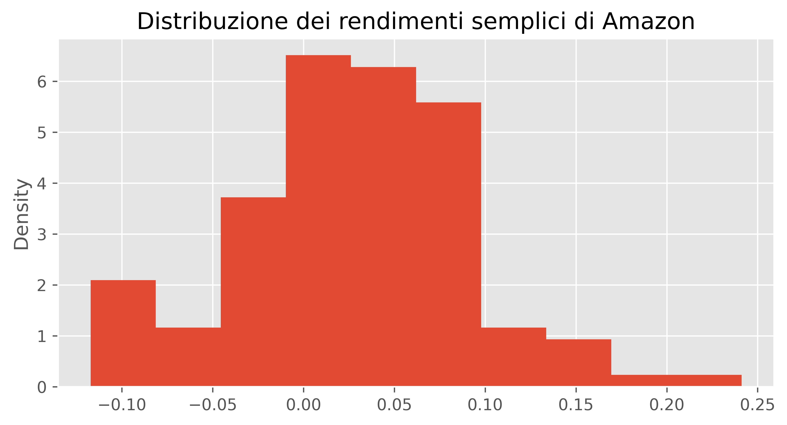
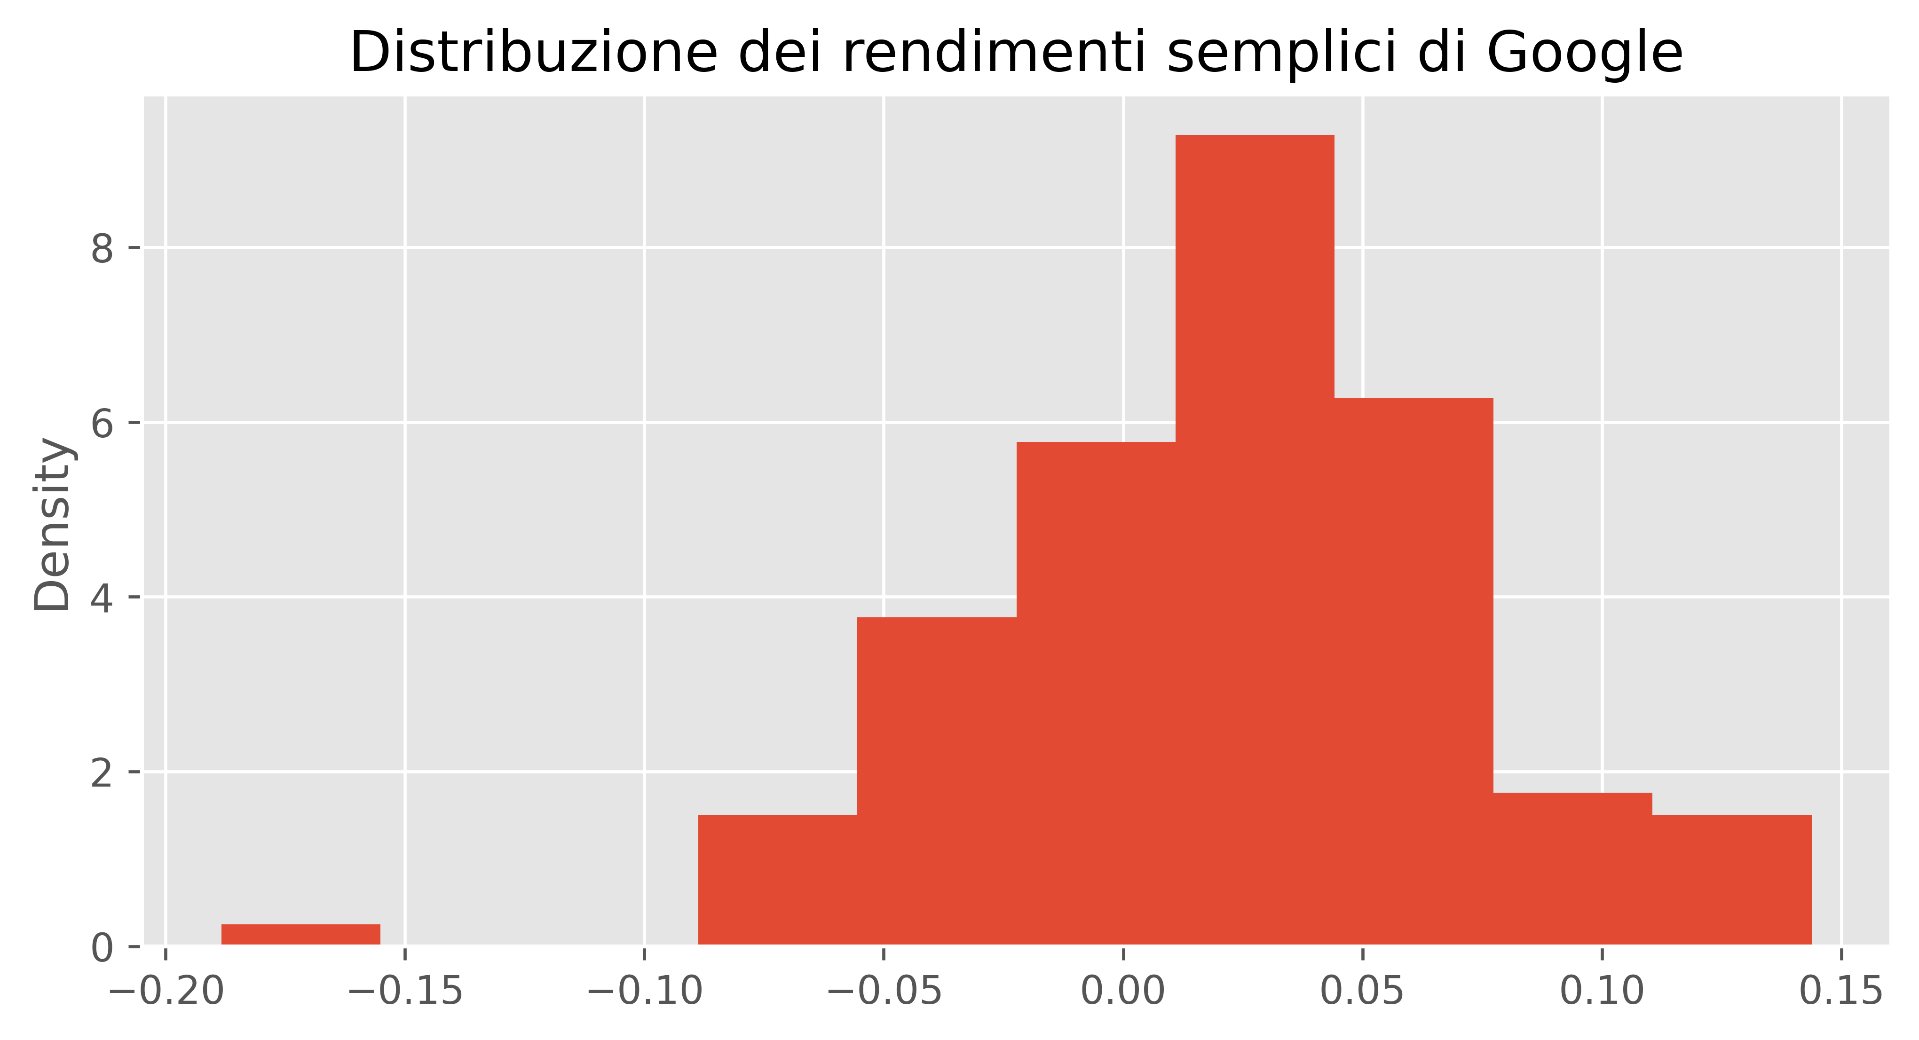
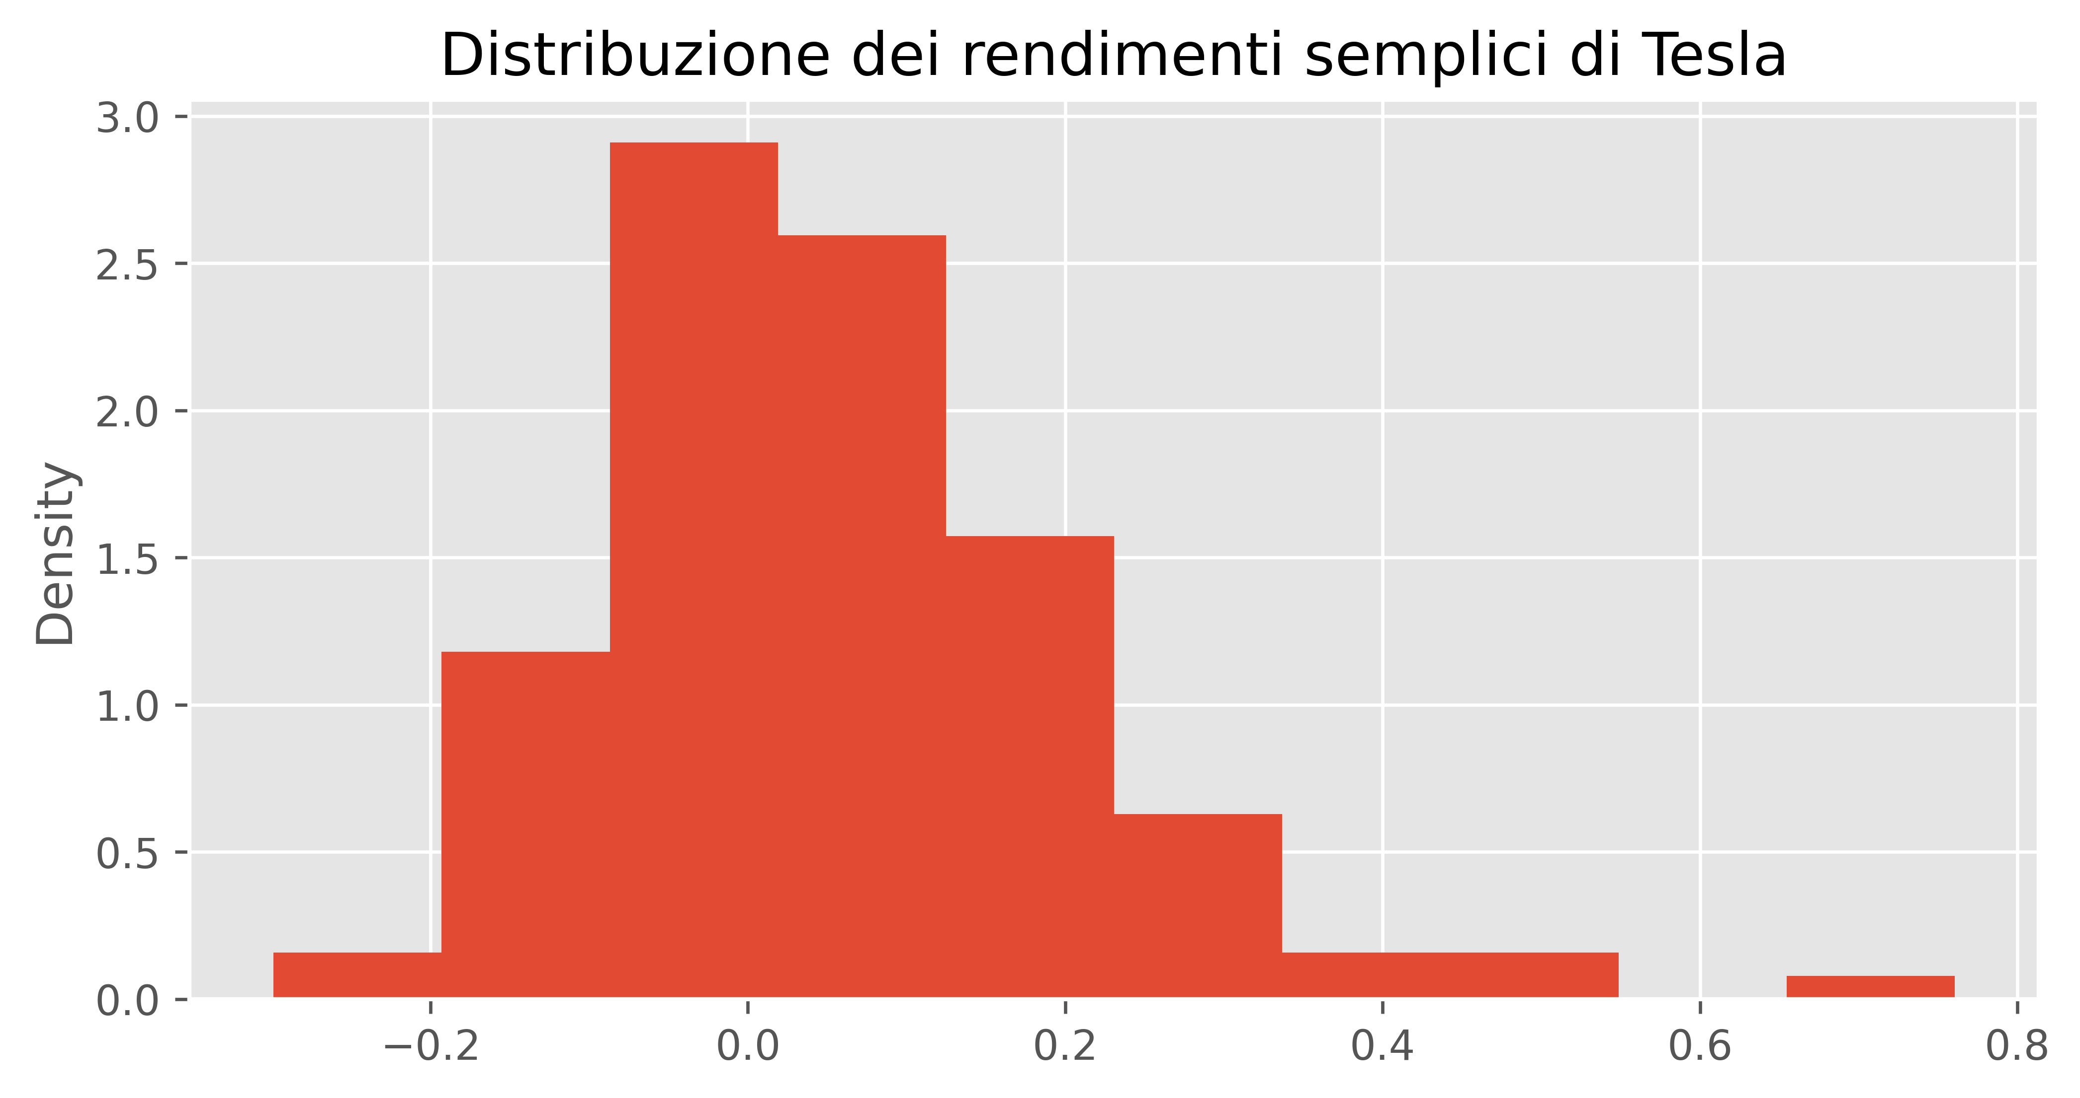
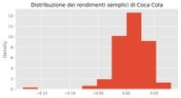
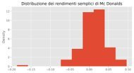
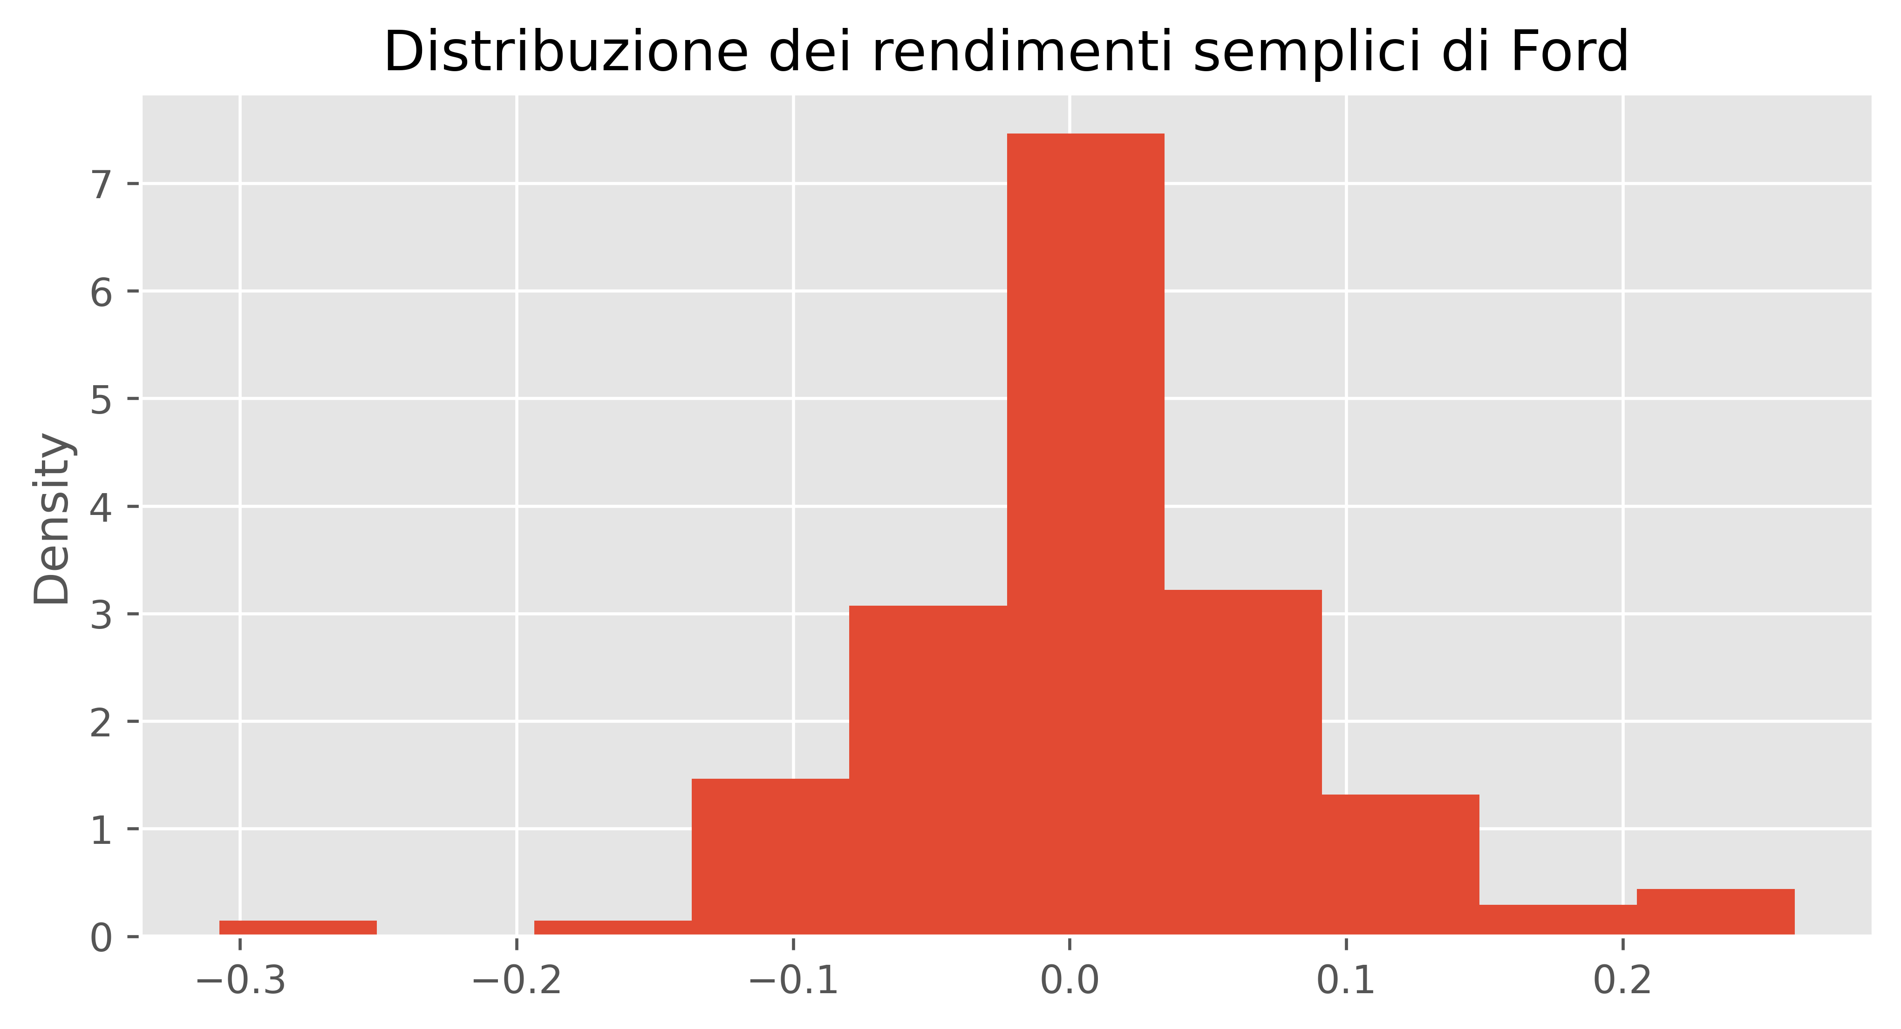
DISTRIBUZIONE DEI RENDIMENTI

Slide 12
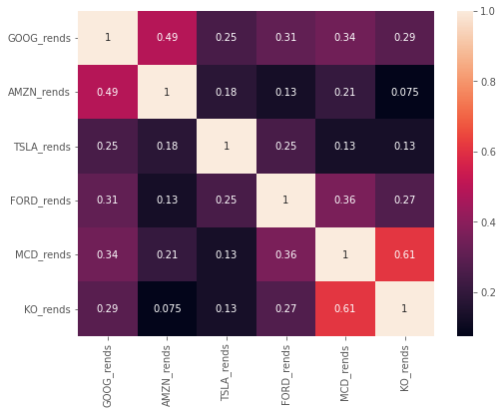
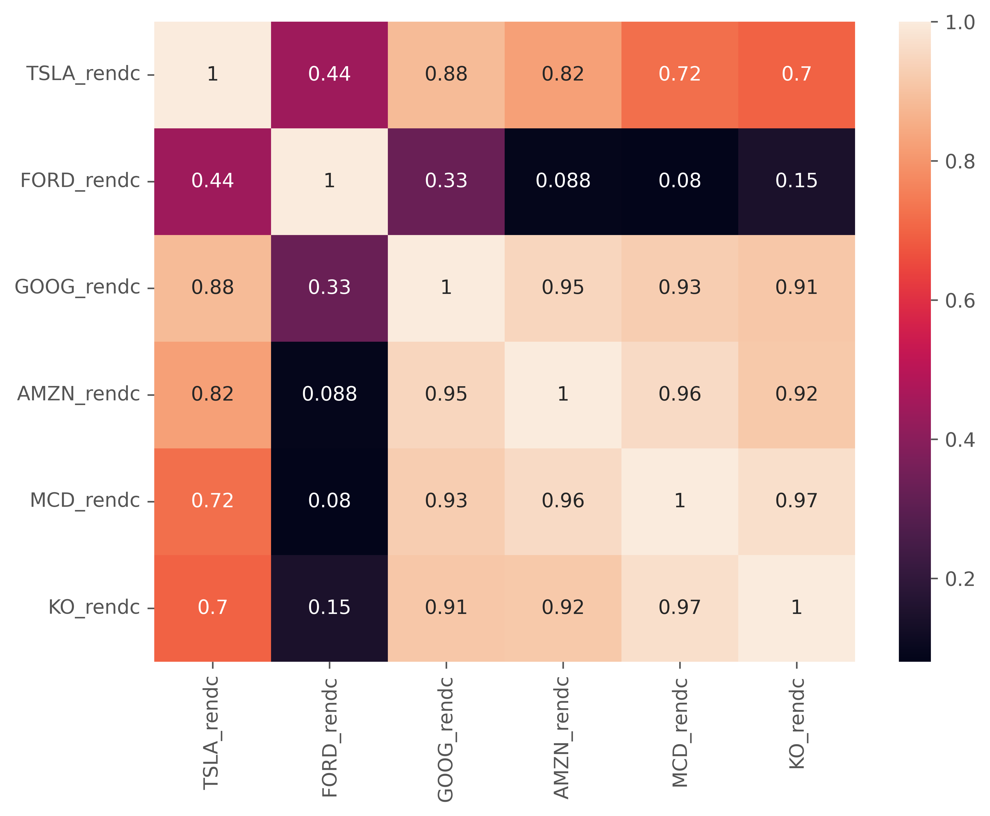
Correlazioni tra i rendimenti dei titoli

Slide 13
CONFRONTO RENDIMENTI SEMPLICI
 | TSLA_rends | FORD_rends | MCD_rends | KO_rends | AMZN_rends | GOOG_rends
count | 120.000000 | 120.000000 | 120.000000 | 120.000000 | 120.000000 | 120.000000
mean | 0.054119 | 0.011329 | 0.011129 | 0.007301 | 0.026528 | 0.020519
std | 0.154079 | 0.076942 | 0.036345 | 0.031387 | 0.064558 | 0.050291
min | -0.298886 | -0.307438 | -0.186207 | -0.183507 | -0.117195 | -0.188317
25% | -0.051894 | -0.024712 | -0.009927 | -0.010082 | -0.009762 | -0.011698
50% | 0.036486 | 0.004308 | 0.012107 | 0.007659 | 0.030122 | 0.021218
75% | 0.136759 | 0.052364 | 0.034424 | 0.027617 | 0.066965 | 0.049572
max | 0.760534 | 0.262065 | 0.096510 | 0.079571 | 0.241118 | 0.143760

Slide 14
CONFRONTO RENDIMENTI COMPOSTI
 | TSLA_rendc | FORD_rendc | GOOG_rendc | AMZN_rendc | MCD_rendc | KO_rendc
count | 120.000000 | 120.000000 | 120.000000 | 120.000000 | 120.000000 | 120.000000
mean | 20.238461 | 1.380724 | 3.232868 | 6.328238 | 1.803992 | 1.557811
std | 34.237683 | 0.296501 | 2.030657 | 5.406425 | 0.761401 | 0.334820
min | 0.839646 | 0.684981 | 0.952009 | 0.952951 | 0.920784 | 1.009491
25% | 6.118913 | 1.198941 | 1.802029 | 1.700518 | 1.089108 | 1.294457
50% | 7.500514 | 1.379634 | 2.630187 | 4.151205 | 1.513117 | 1.506187
75% | 10.383777 | 1.537747 | 3.960175 | 9.334767 | 2.403840 | 1.791388
max | 171.145755 | 2.722944 | 9.875716 | 18.804962 | 3.484914 | 2.266576

Slide 15
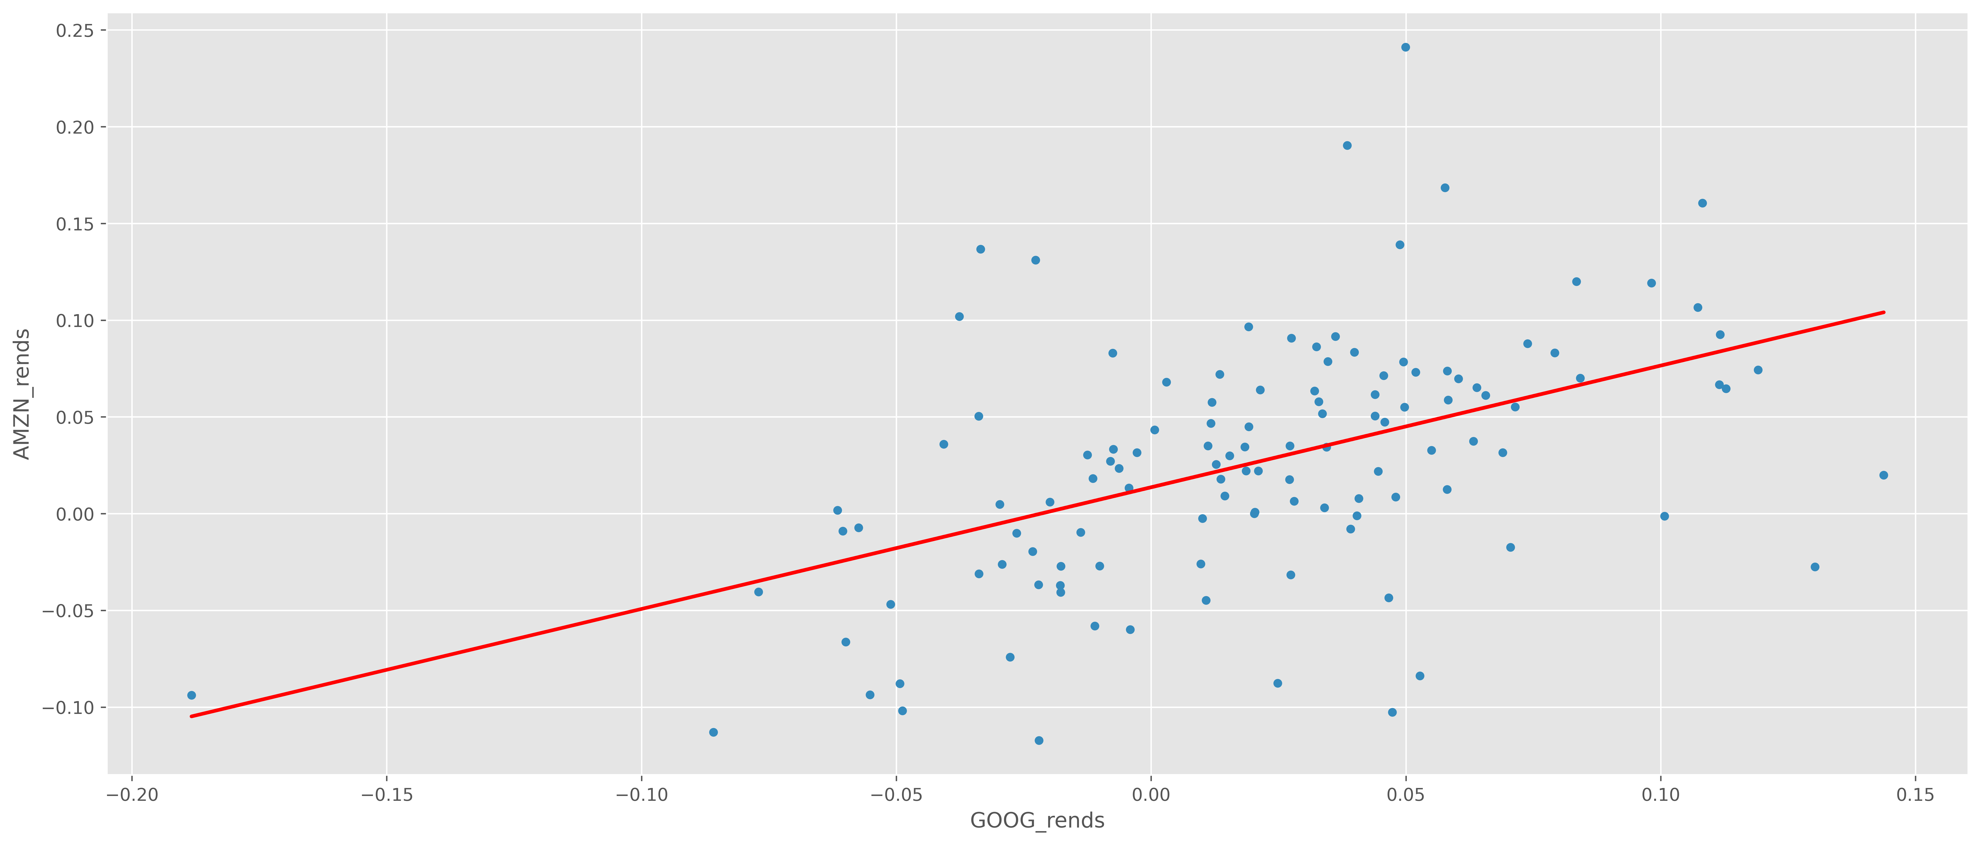
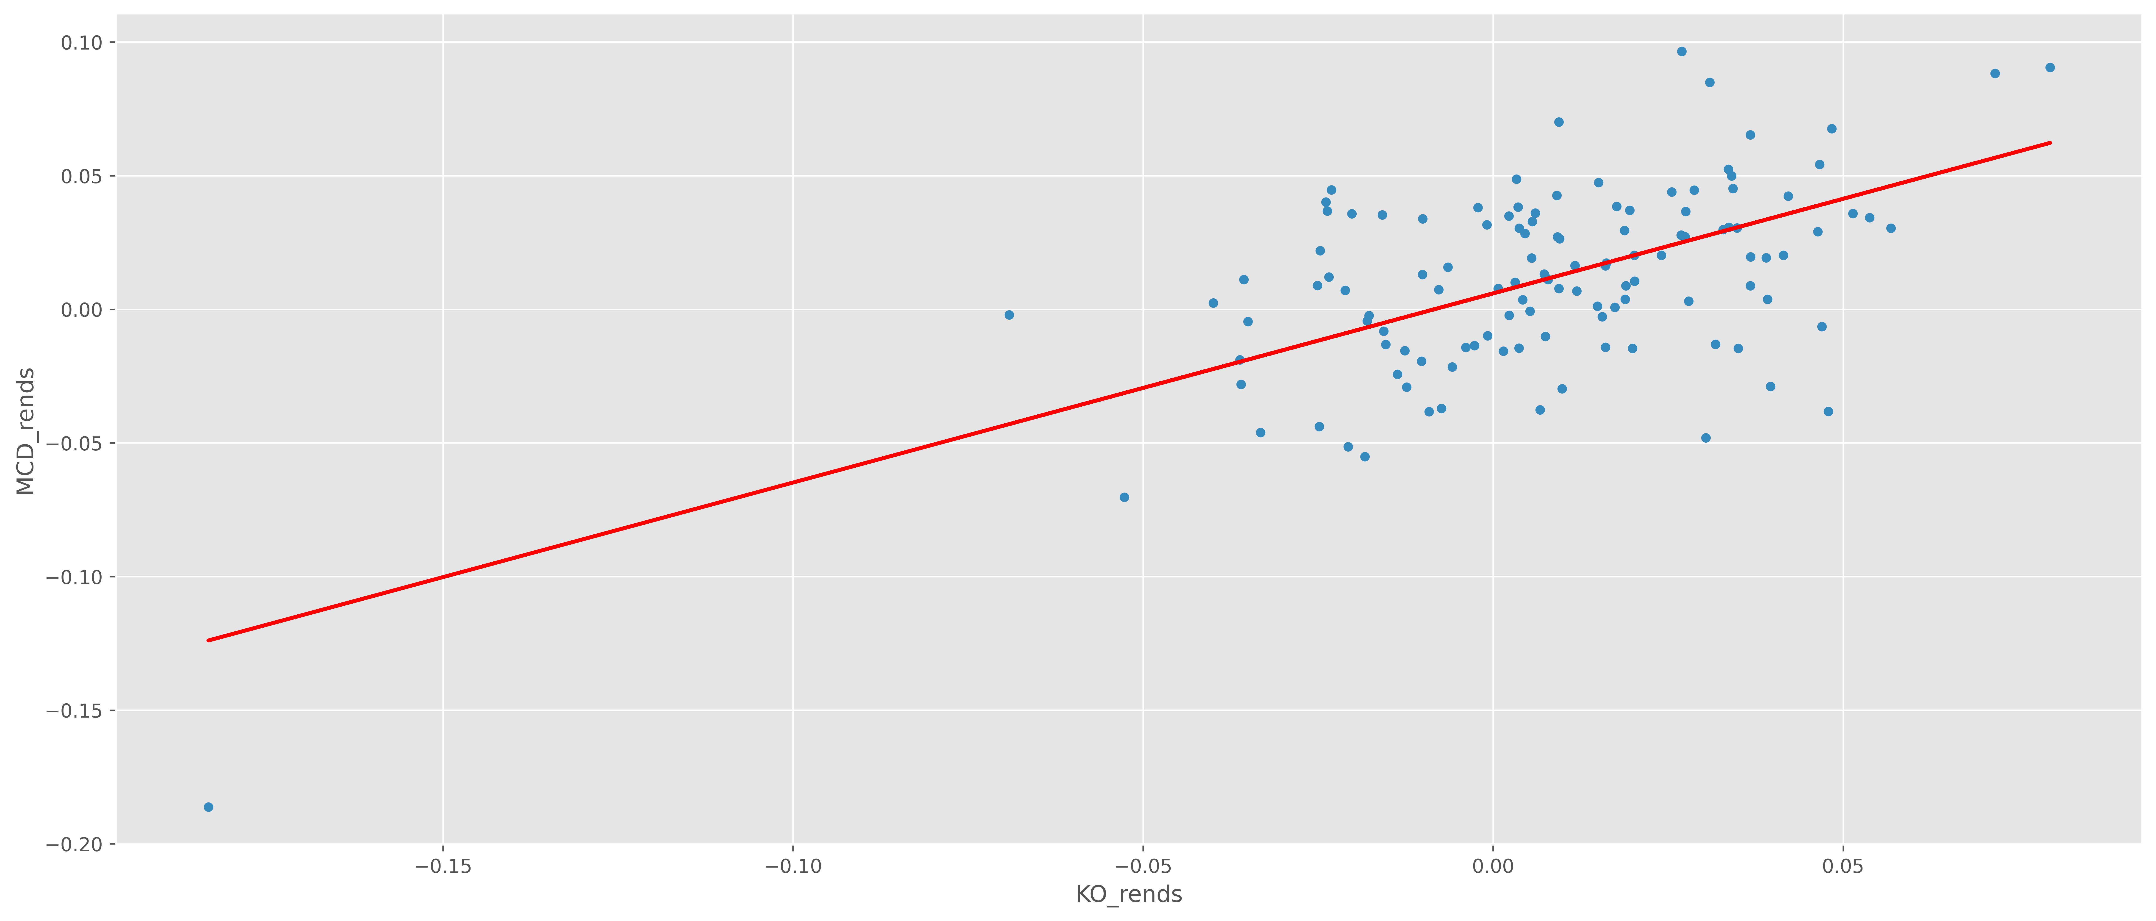
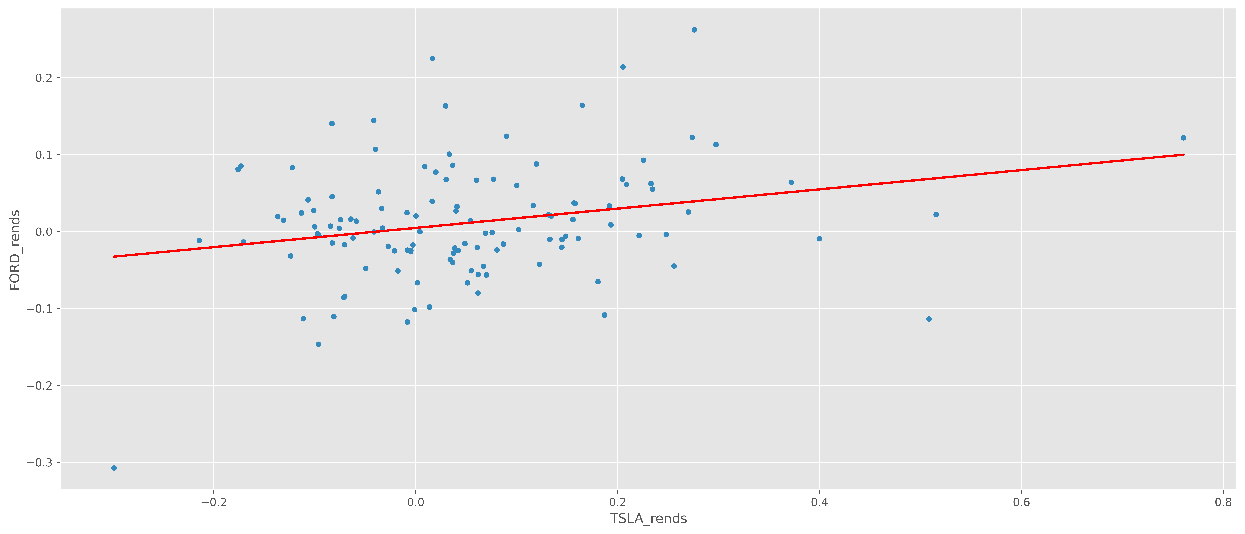
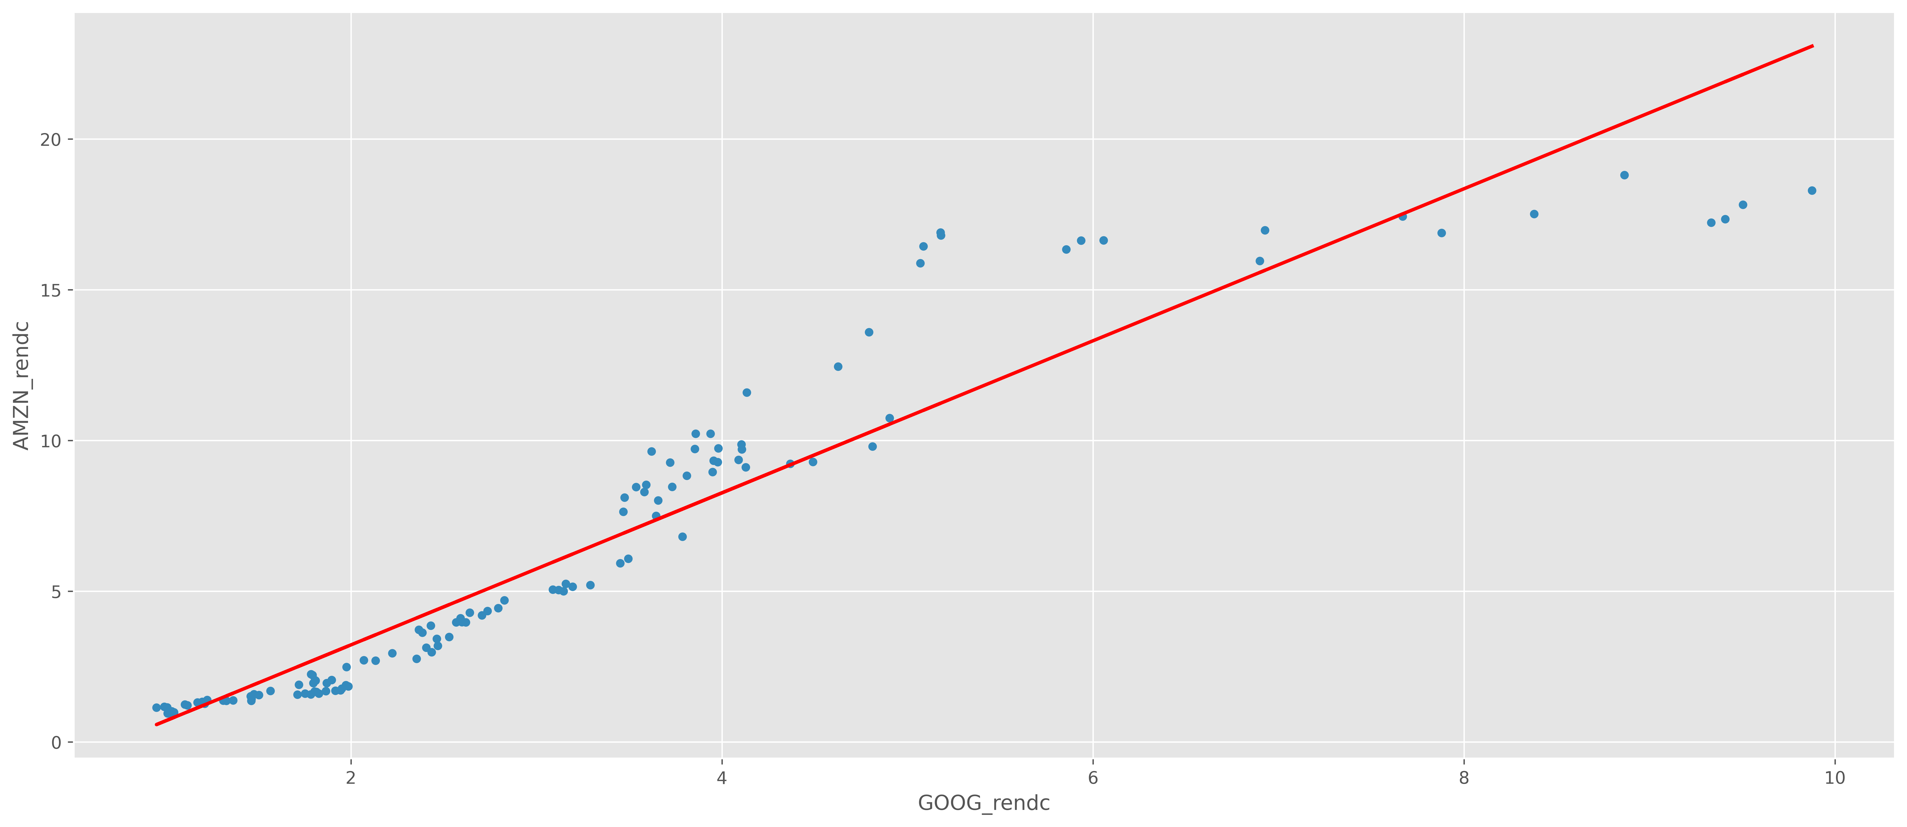
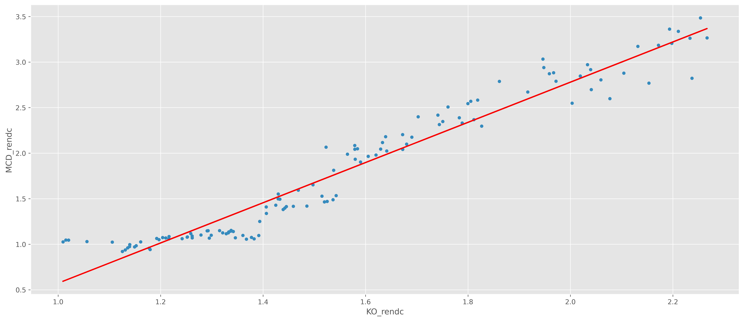
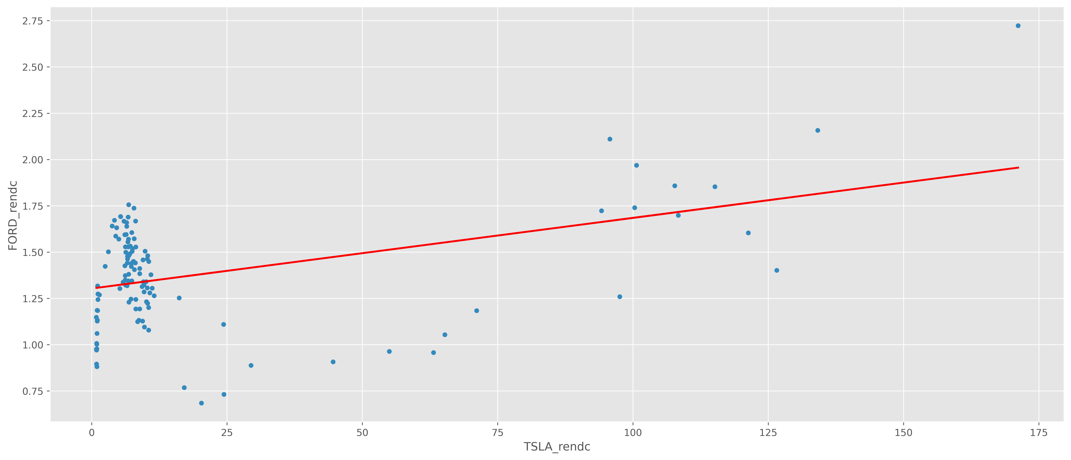
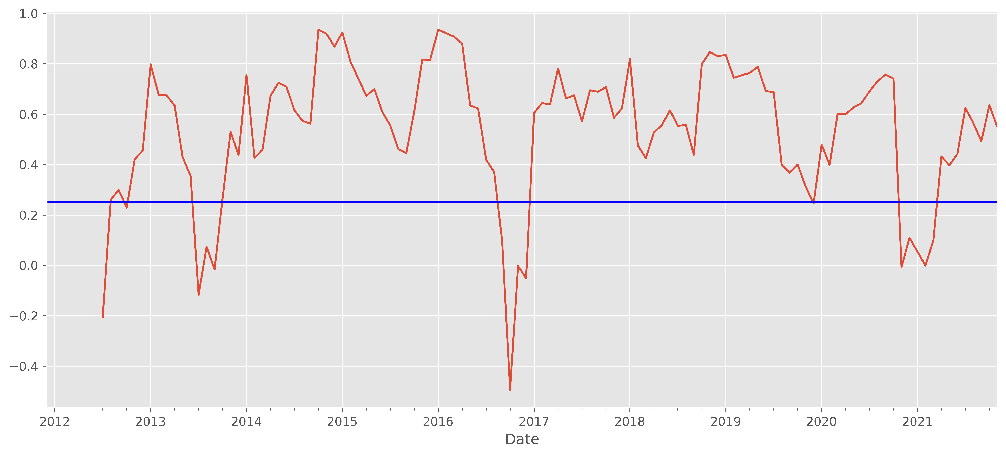
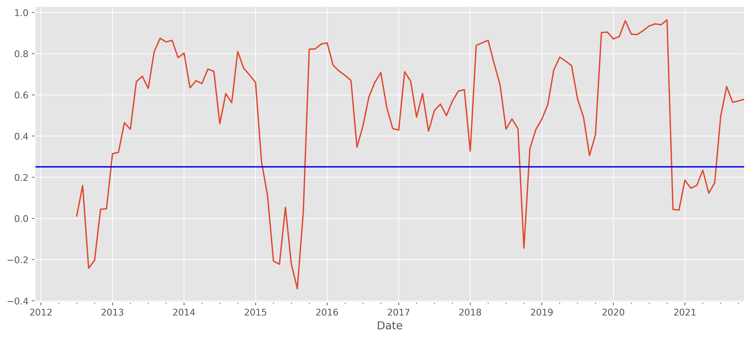
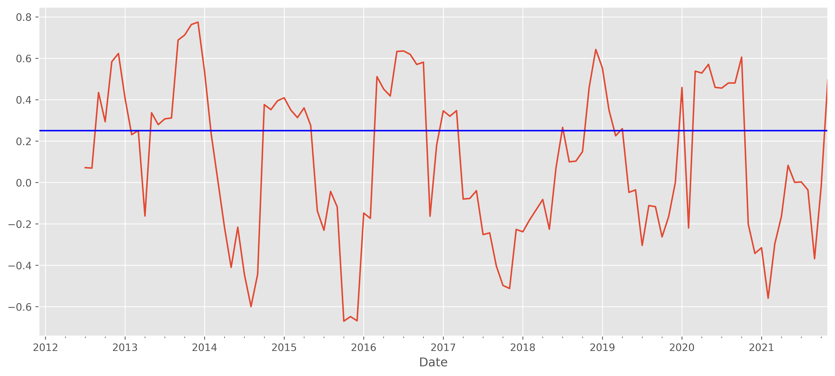
CORRELAZIONI RENDIMENTI GOOG-AMZN KO-MCD TSLA-F

Slide 16
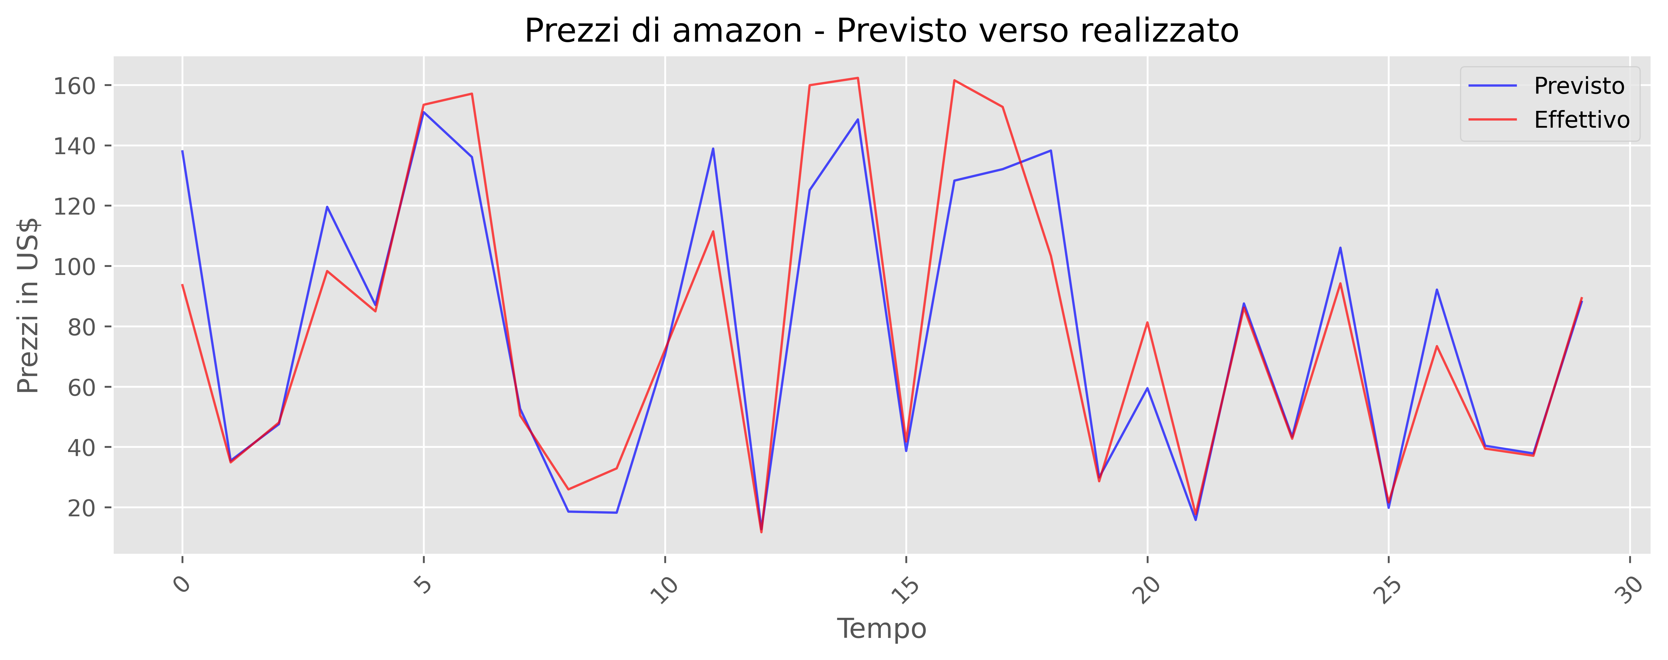
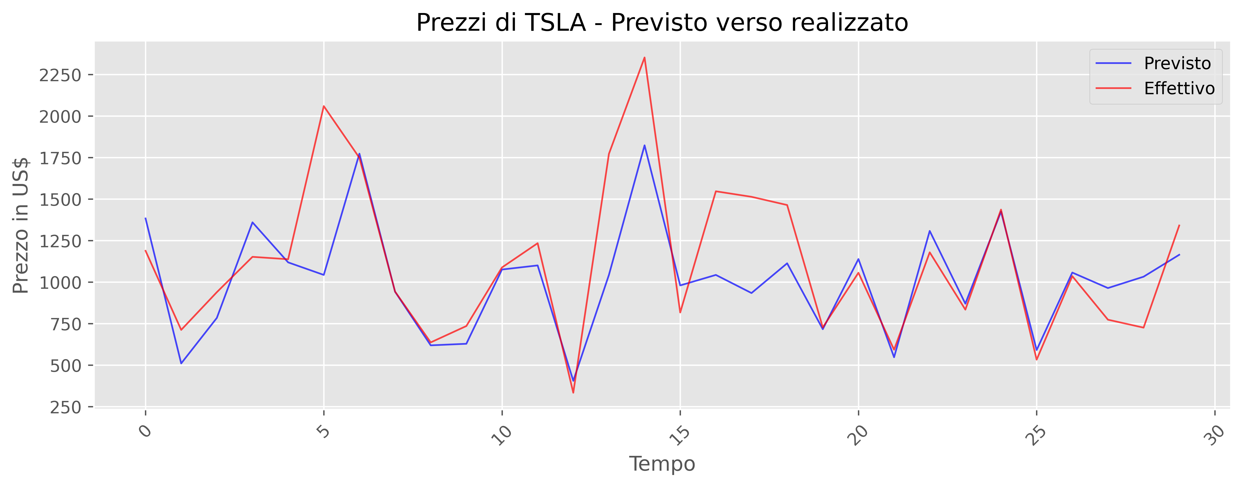
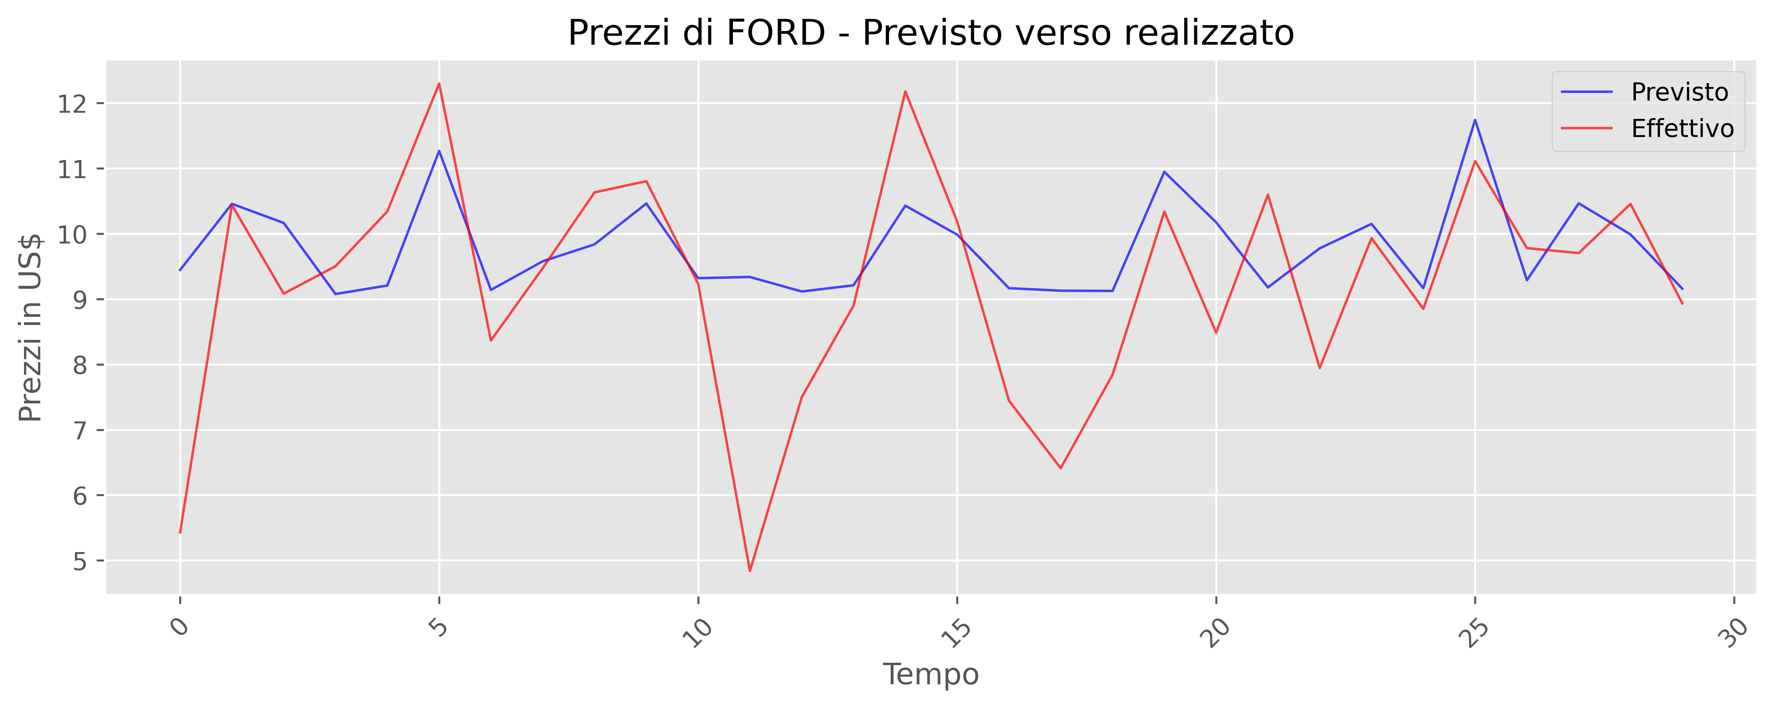
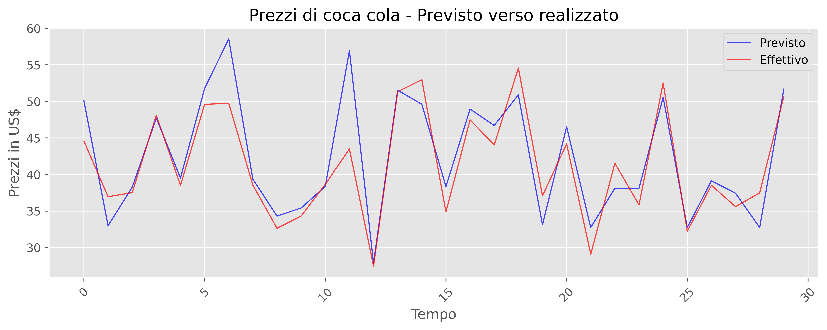
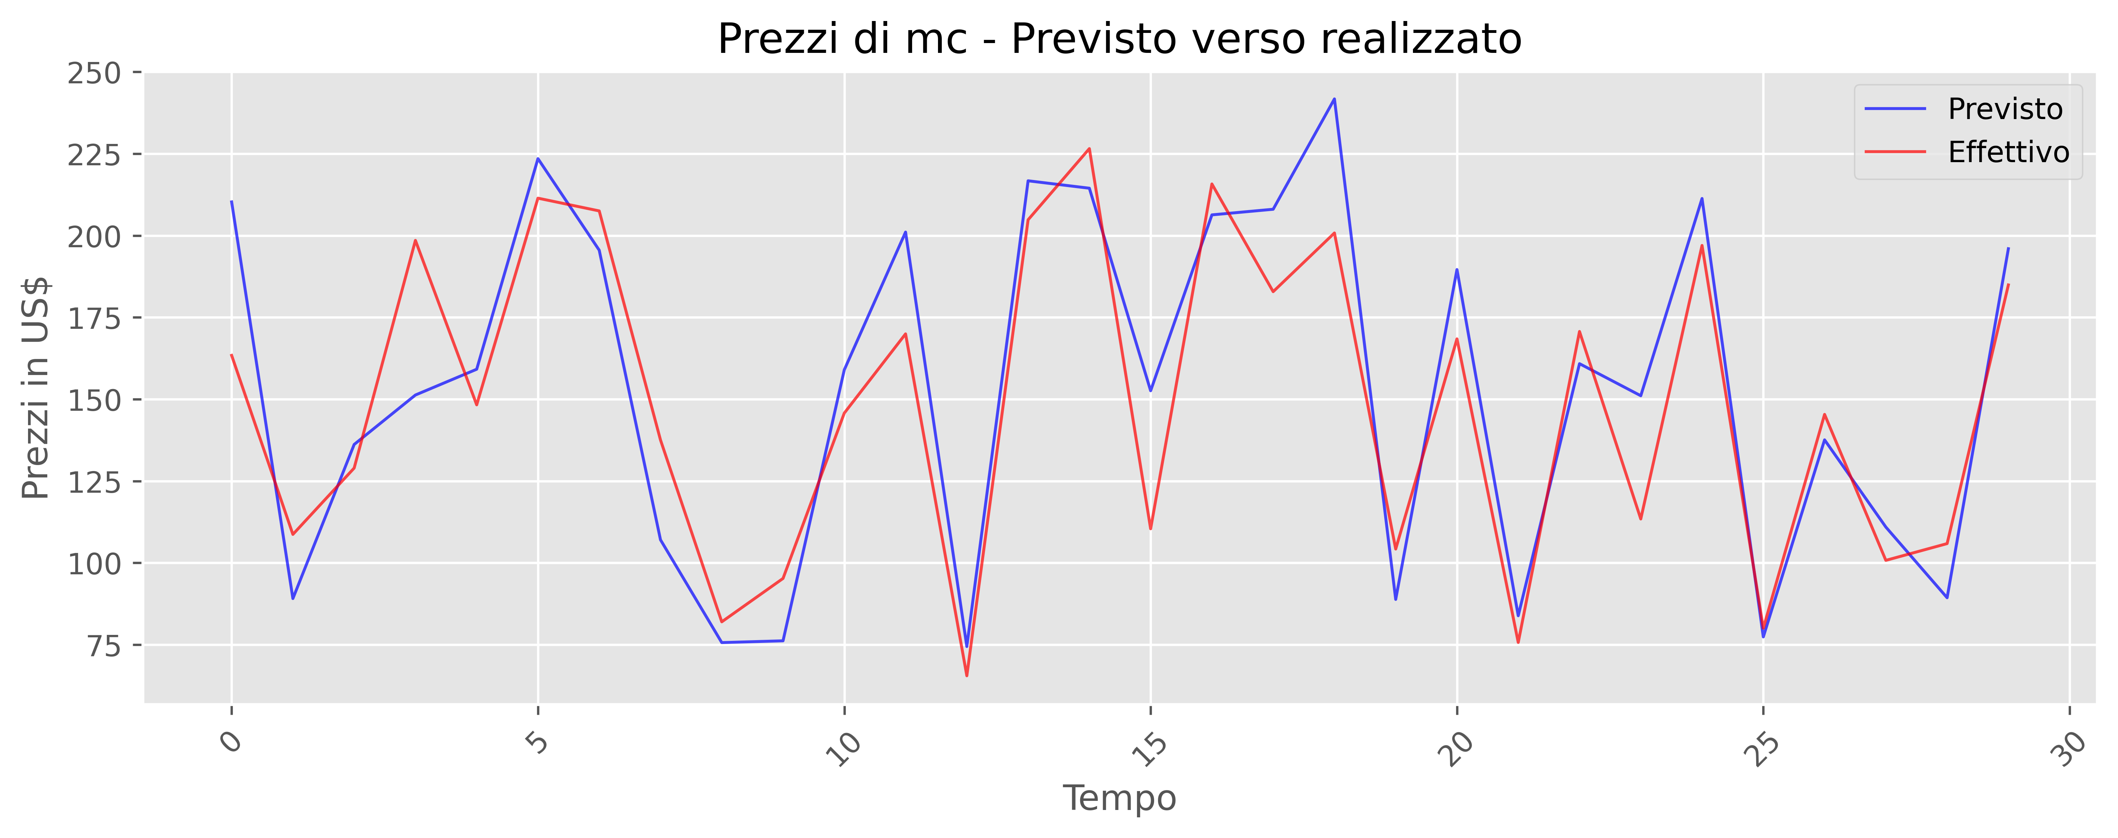
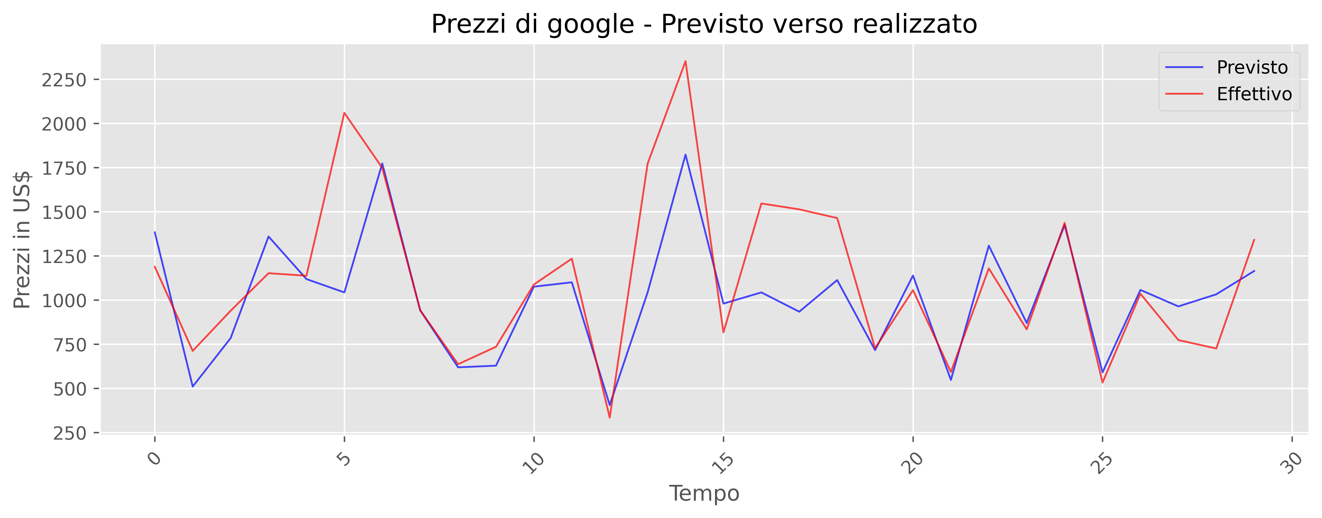
3. PREVISIONI PREZZI SVR
Confidenza AMZN: 87% Confidenza TSLA: 75% Confidenza F: 22%
Confidenza KO: 73% Confidenza MCD: 77% Confidenza GOOG: 54%

Slide 17
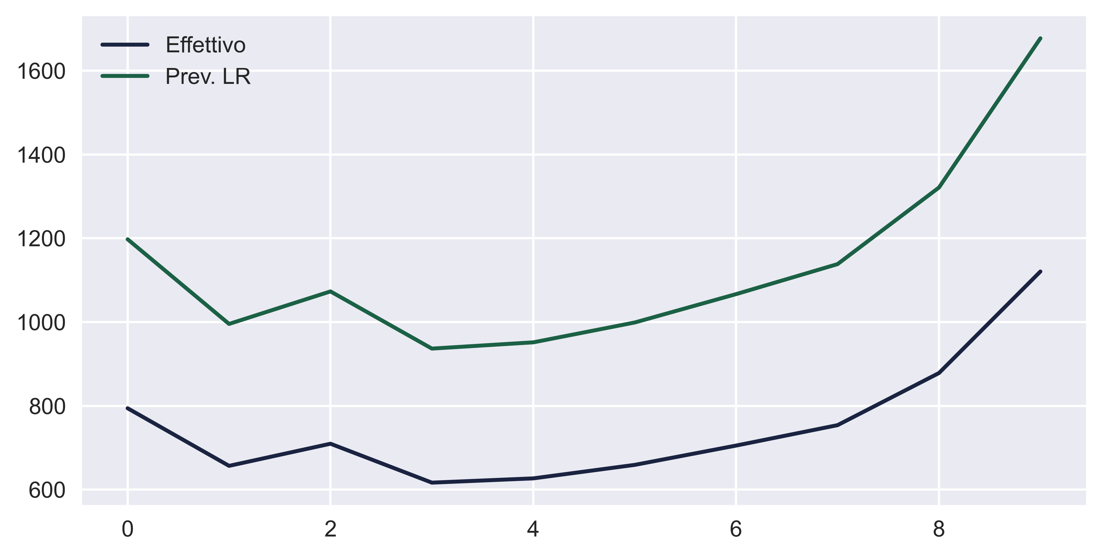
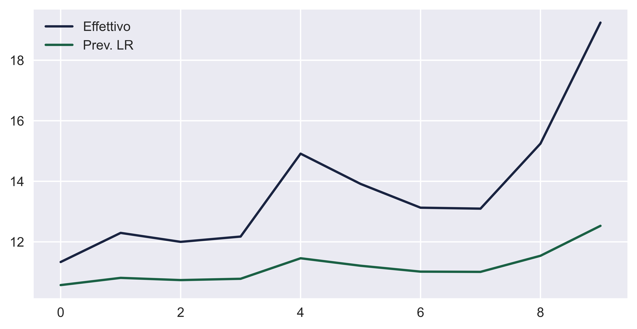
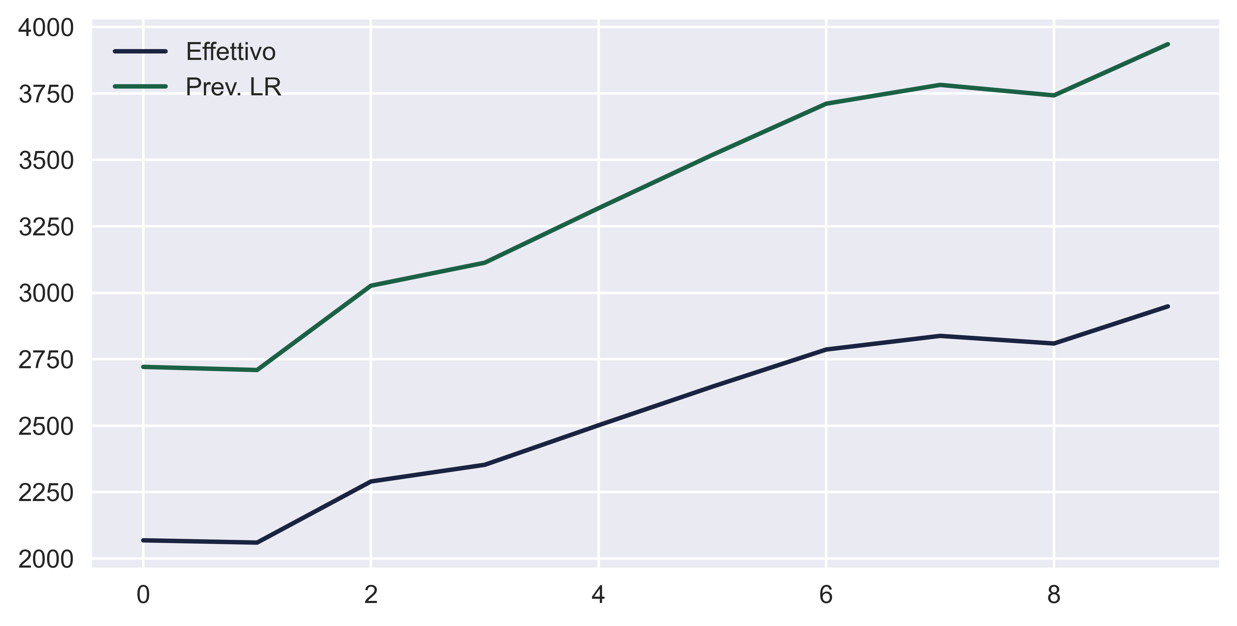
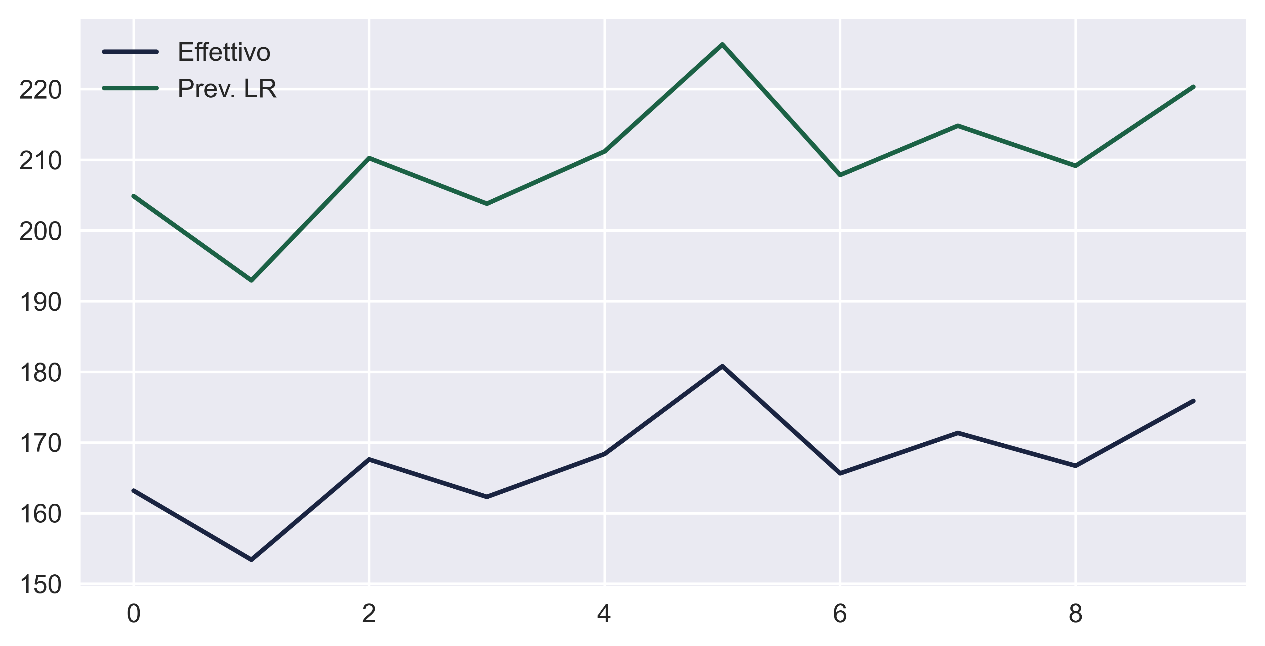
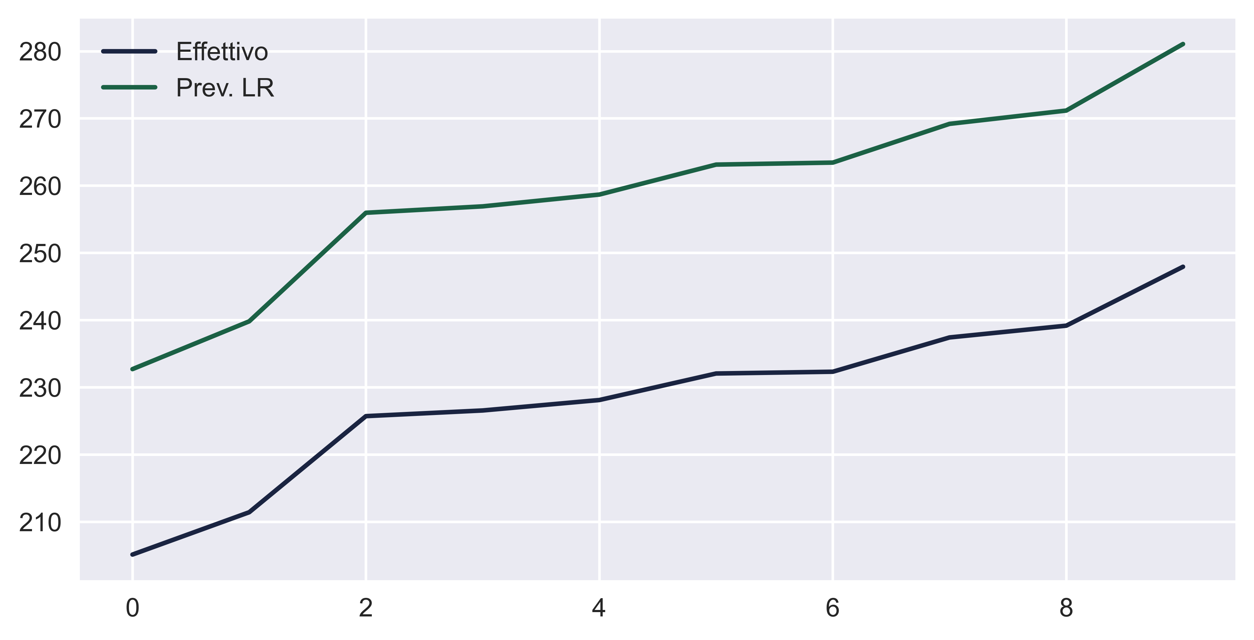
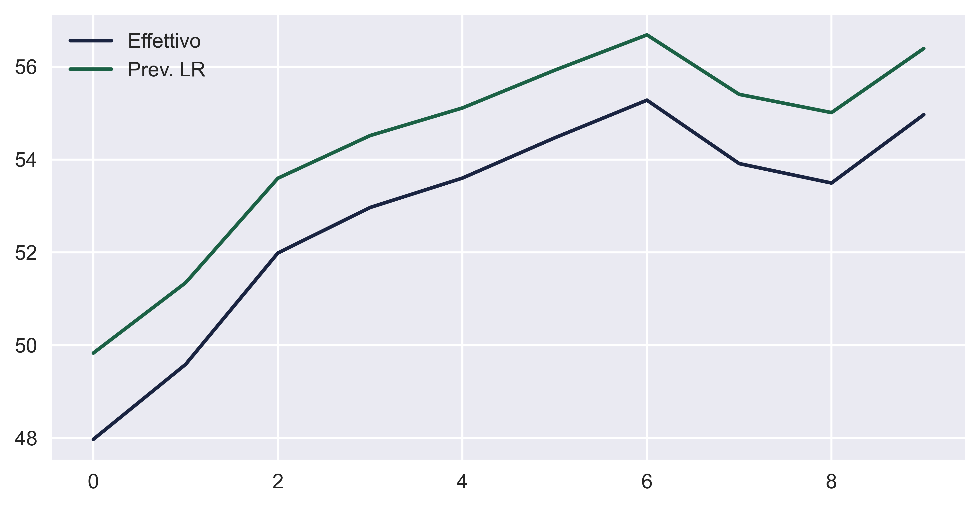
PREVISIONI PREZZI LR
Confidenza TSLA: 57% Confidenza F: 5% Confidenza GOOG: 89%
TSLA
F
GOOG
MCD
KO
AMZN
Confidenza AMZN: 88% Confidenza MCD: 96% Confidenza KO: 84%

Slide 18
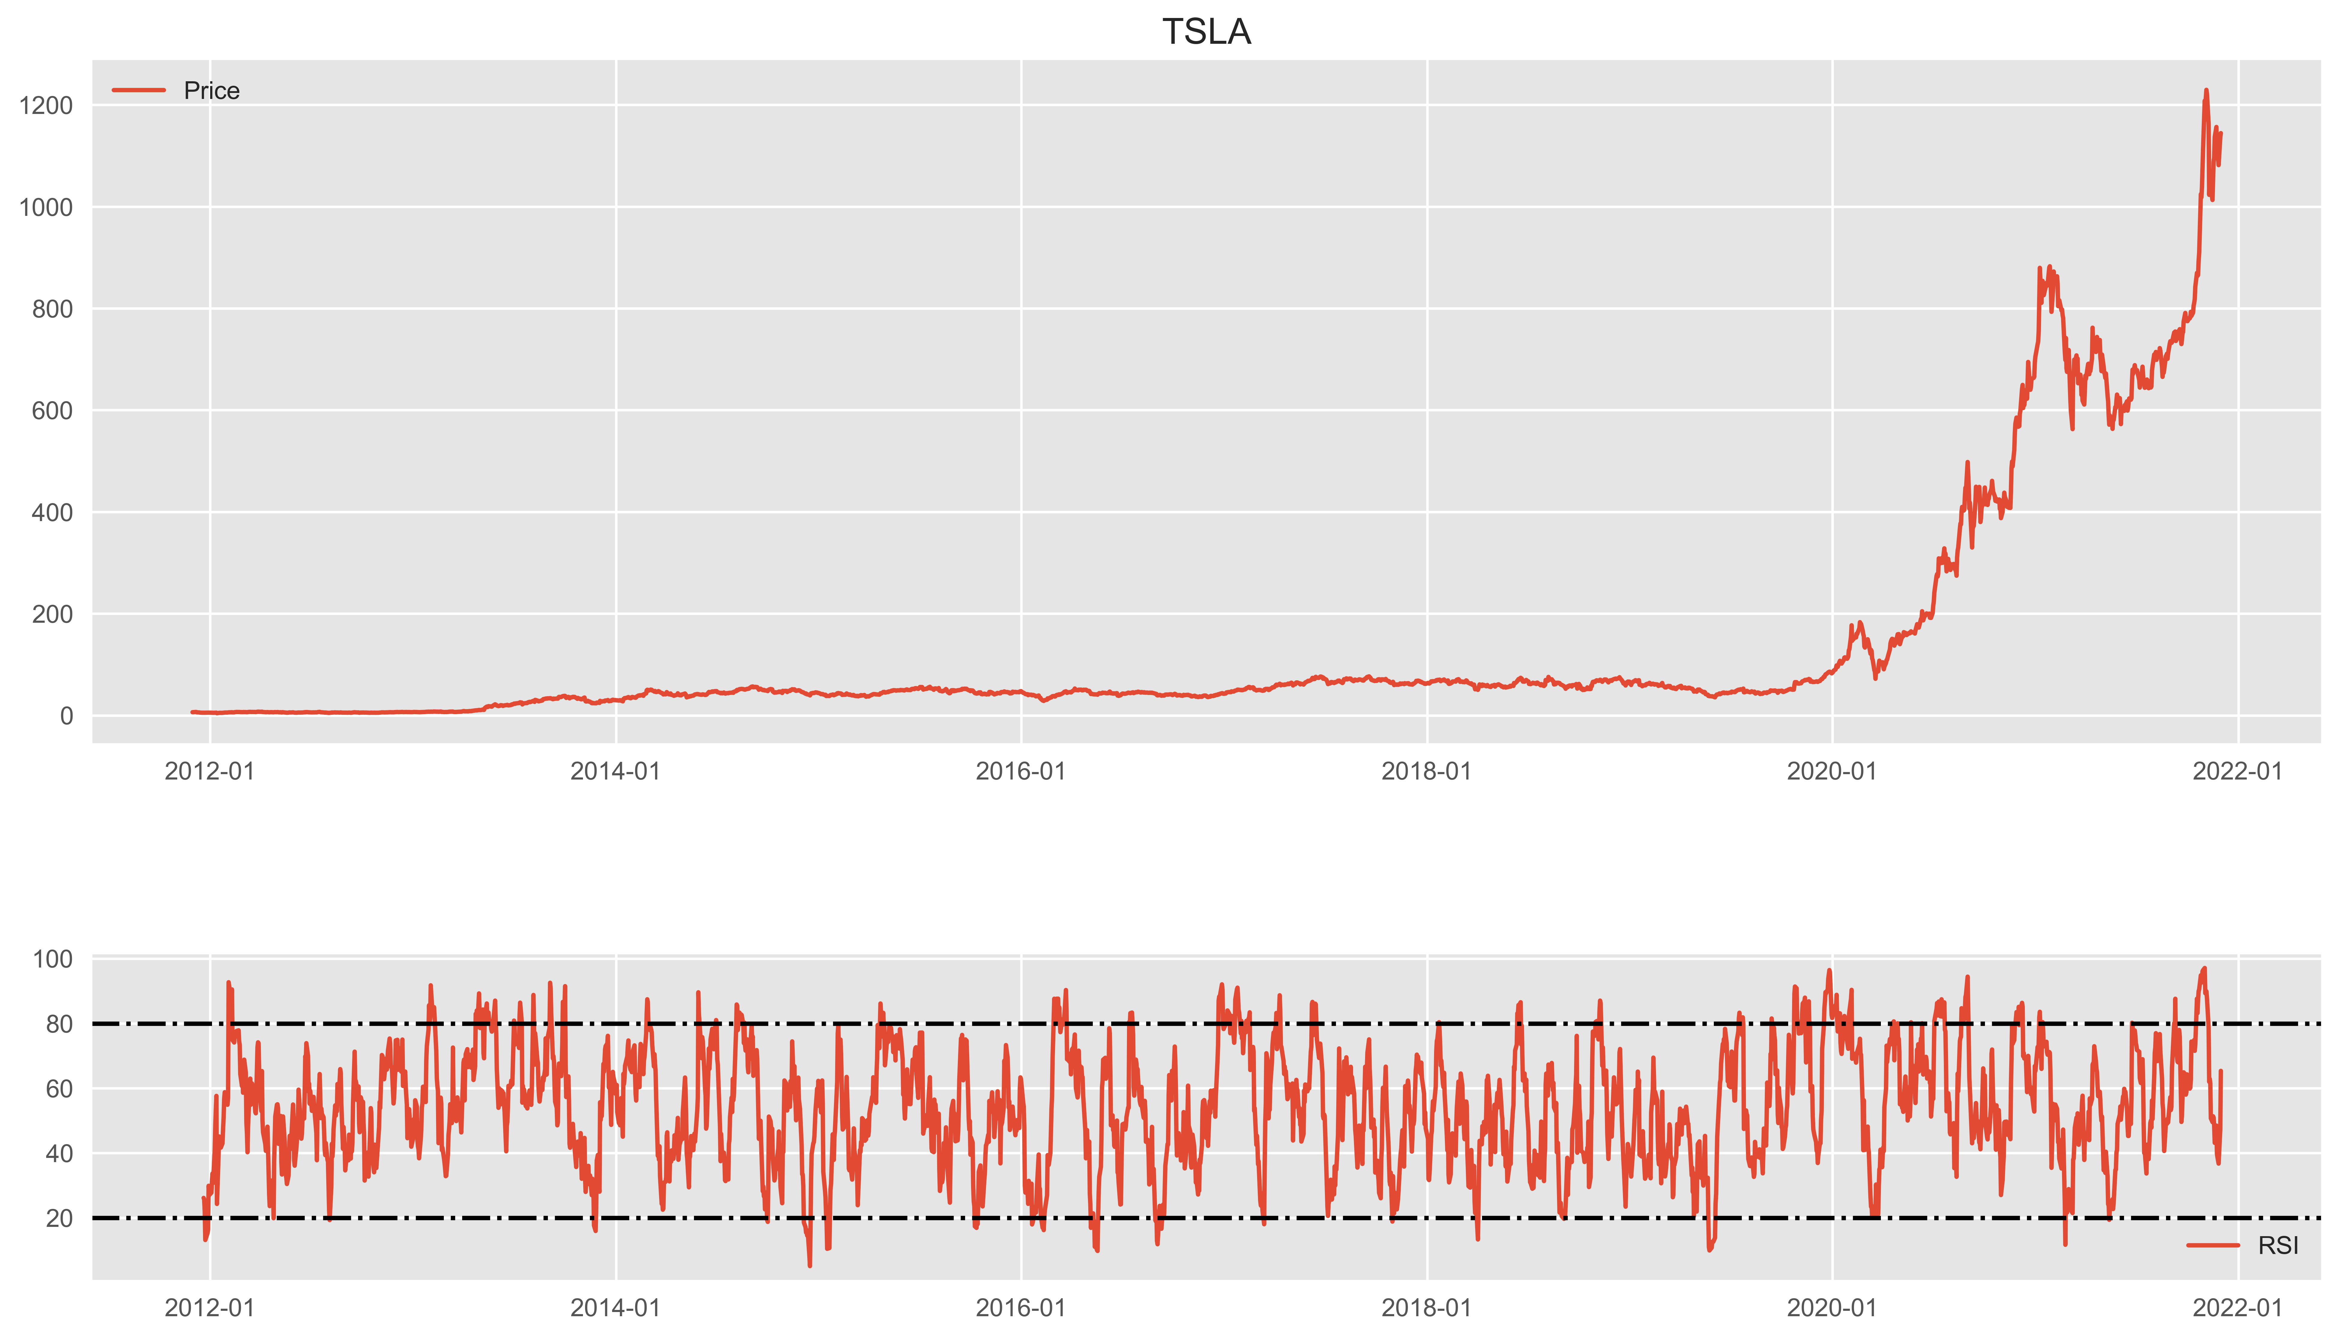
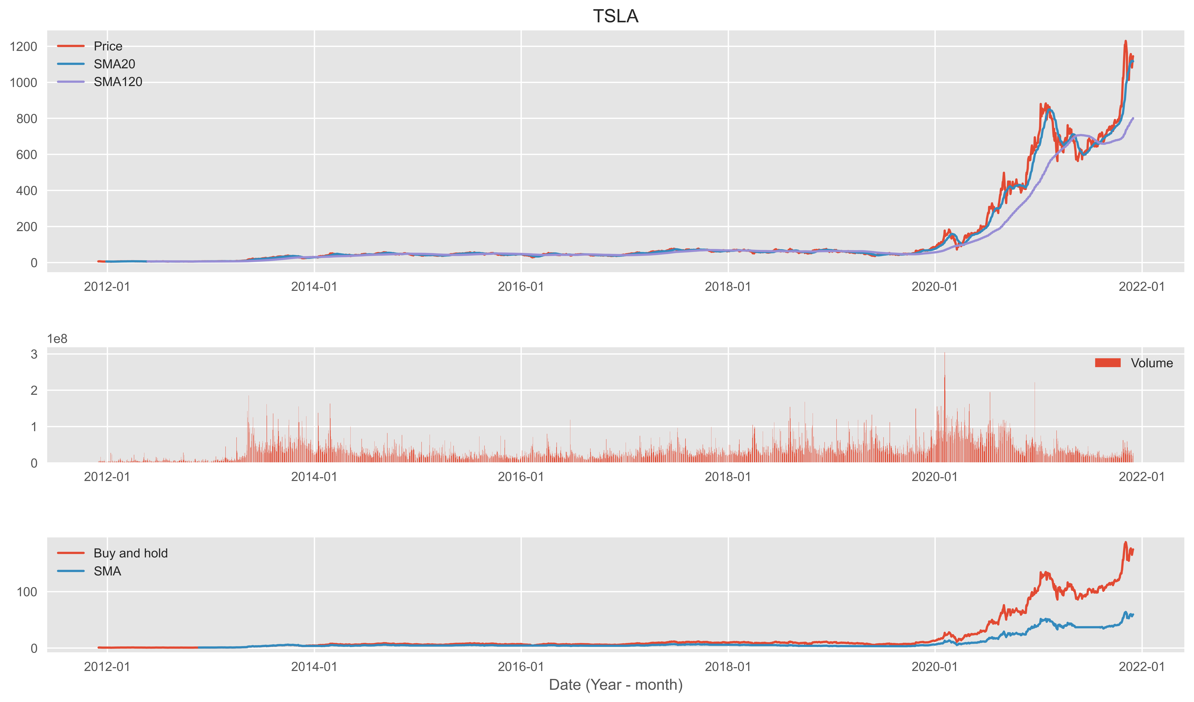
4. TRADING E BACKTESTING TSLA
TICKER | RSI
GOOG | 35.1
KO | 25.3
MCD | 37.2
TSLA | 65.4
AMZN | 44.7
F | 40.9

Slide 19
5. CAPM
Beta TSLA: 1.81
Beta MCD: 0.61
Beta KO: 0.67
Beta F: 1.10​
Beta GOOG: 1.02 ​
Beta AMZN: 1.22
Expected monthly TSLA returns: 0.024
Expected yearly TSLA returns: 0.288
Expected monthly F returns: 0.015 Expected yearly F returns: 0.177
Expected monthly MCD returns: 0.008 Expected yearly MCD returns: 0.101
Expected monthly KO returns: 0.009 Expected yearly KO returns: 0.110
​
Expected monthly AMZN returns: 0.016​ Expected yearly AMZN returns: 0.196
​
Expected monthly GOOG returns: 0.014​ Expected yearly GOOG returns: 0.164

Slide 20
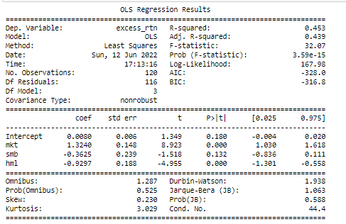
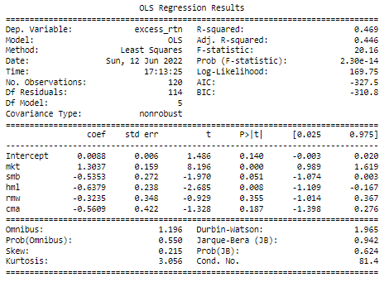
Fattori di rischio FF AMZN
FF3 FF5

Slide 21
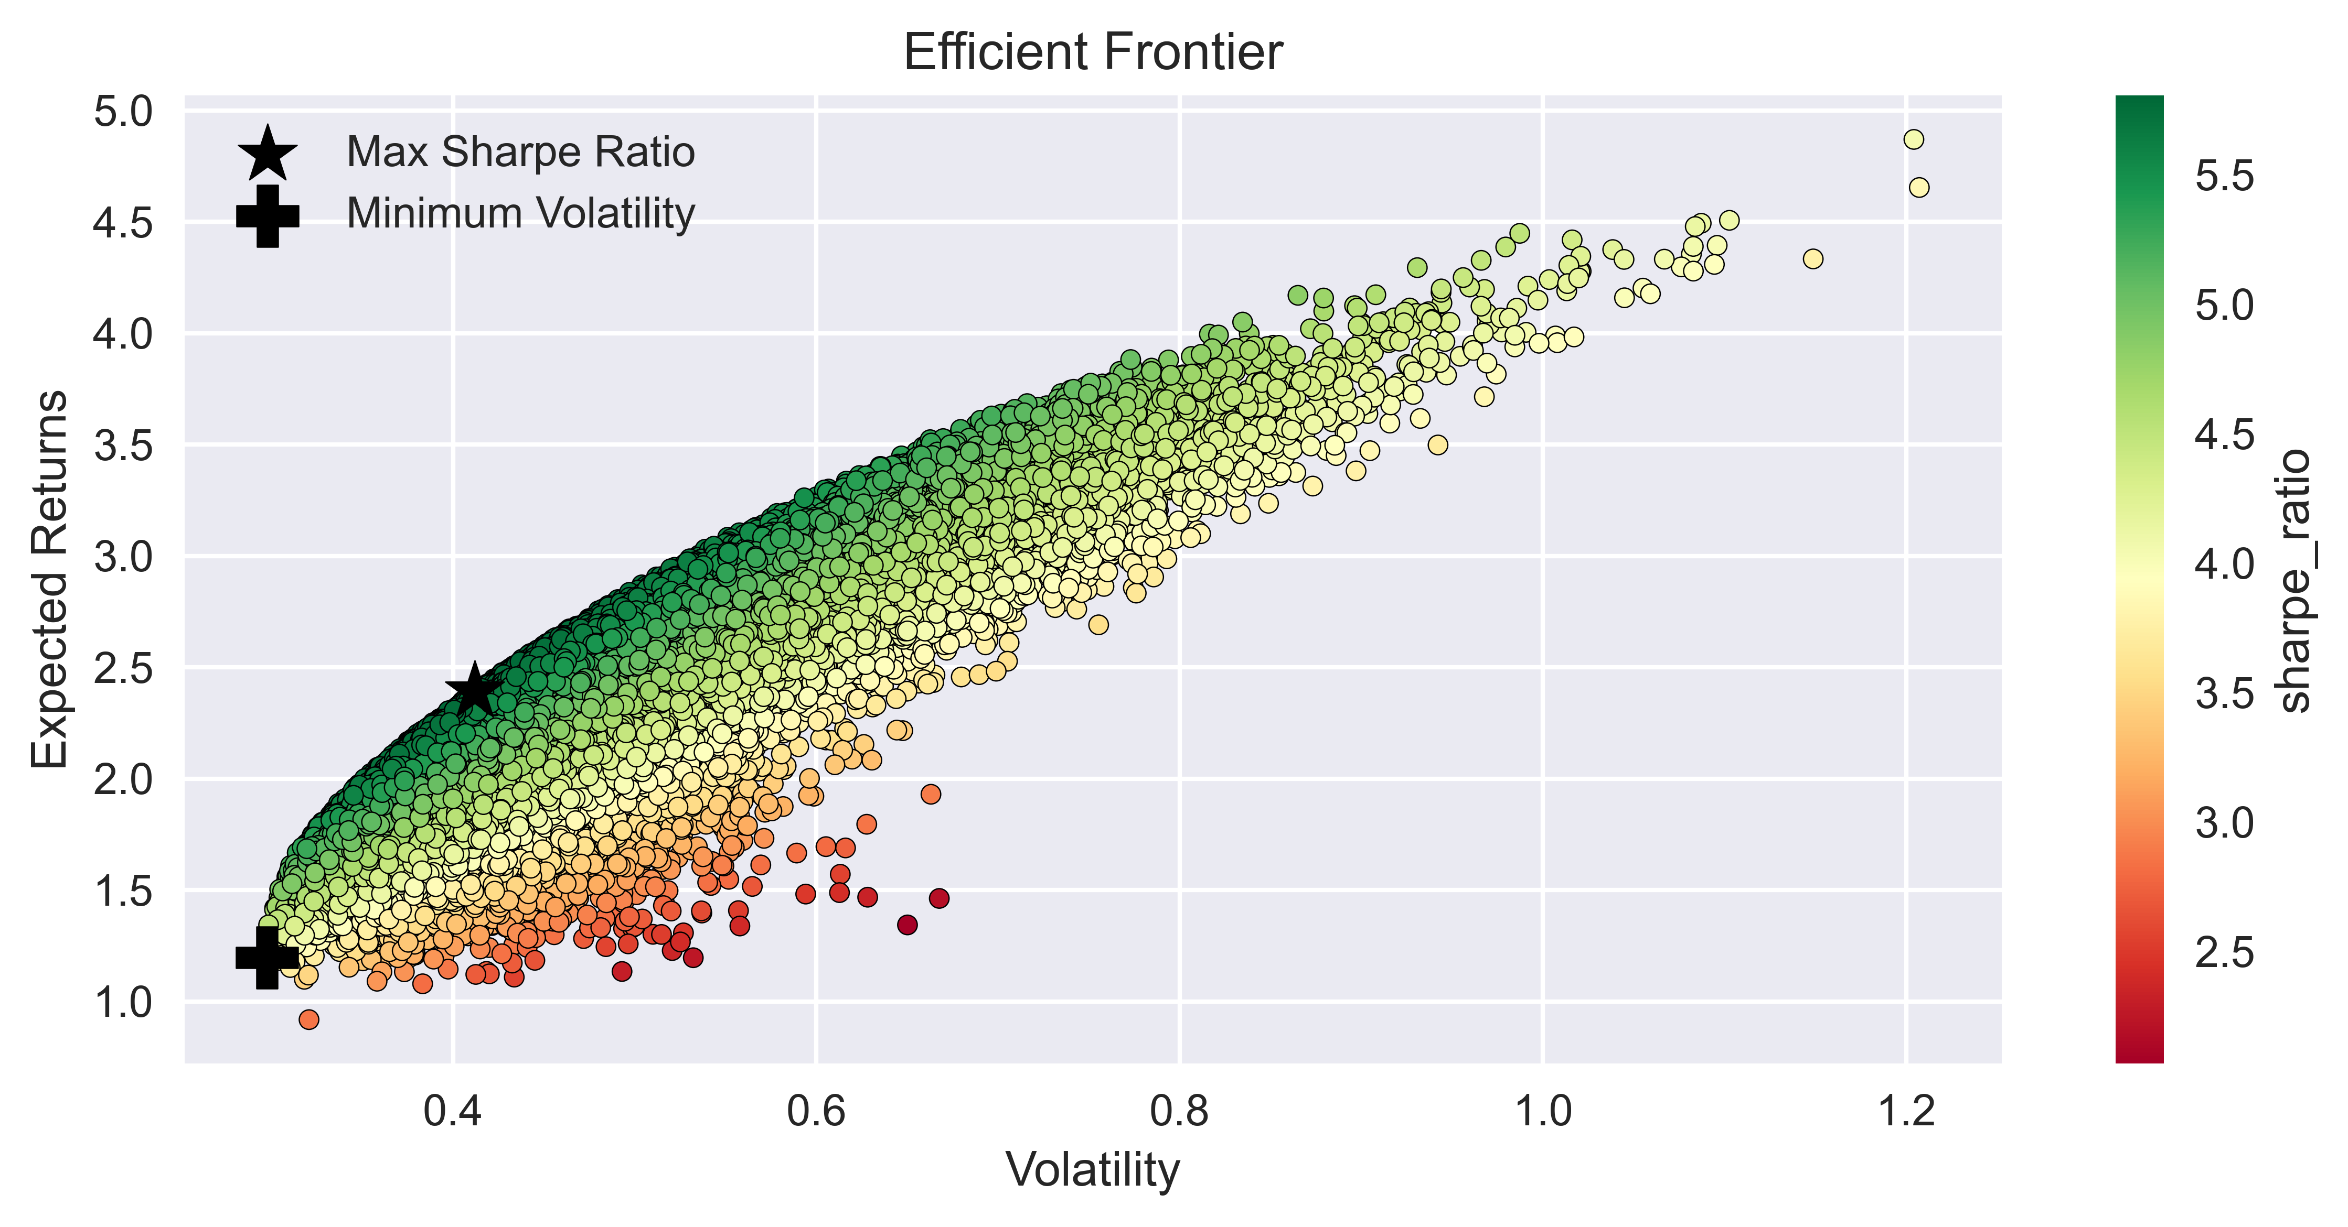
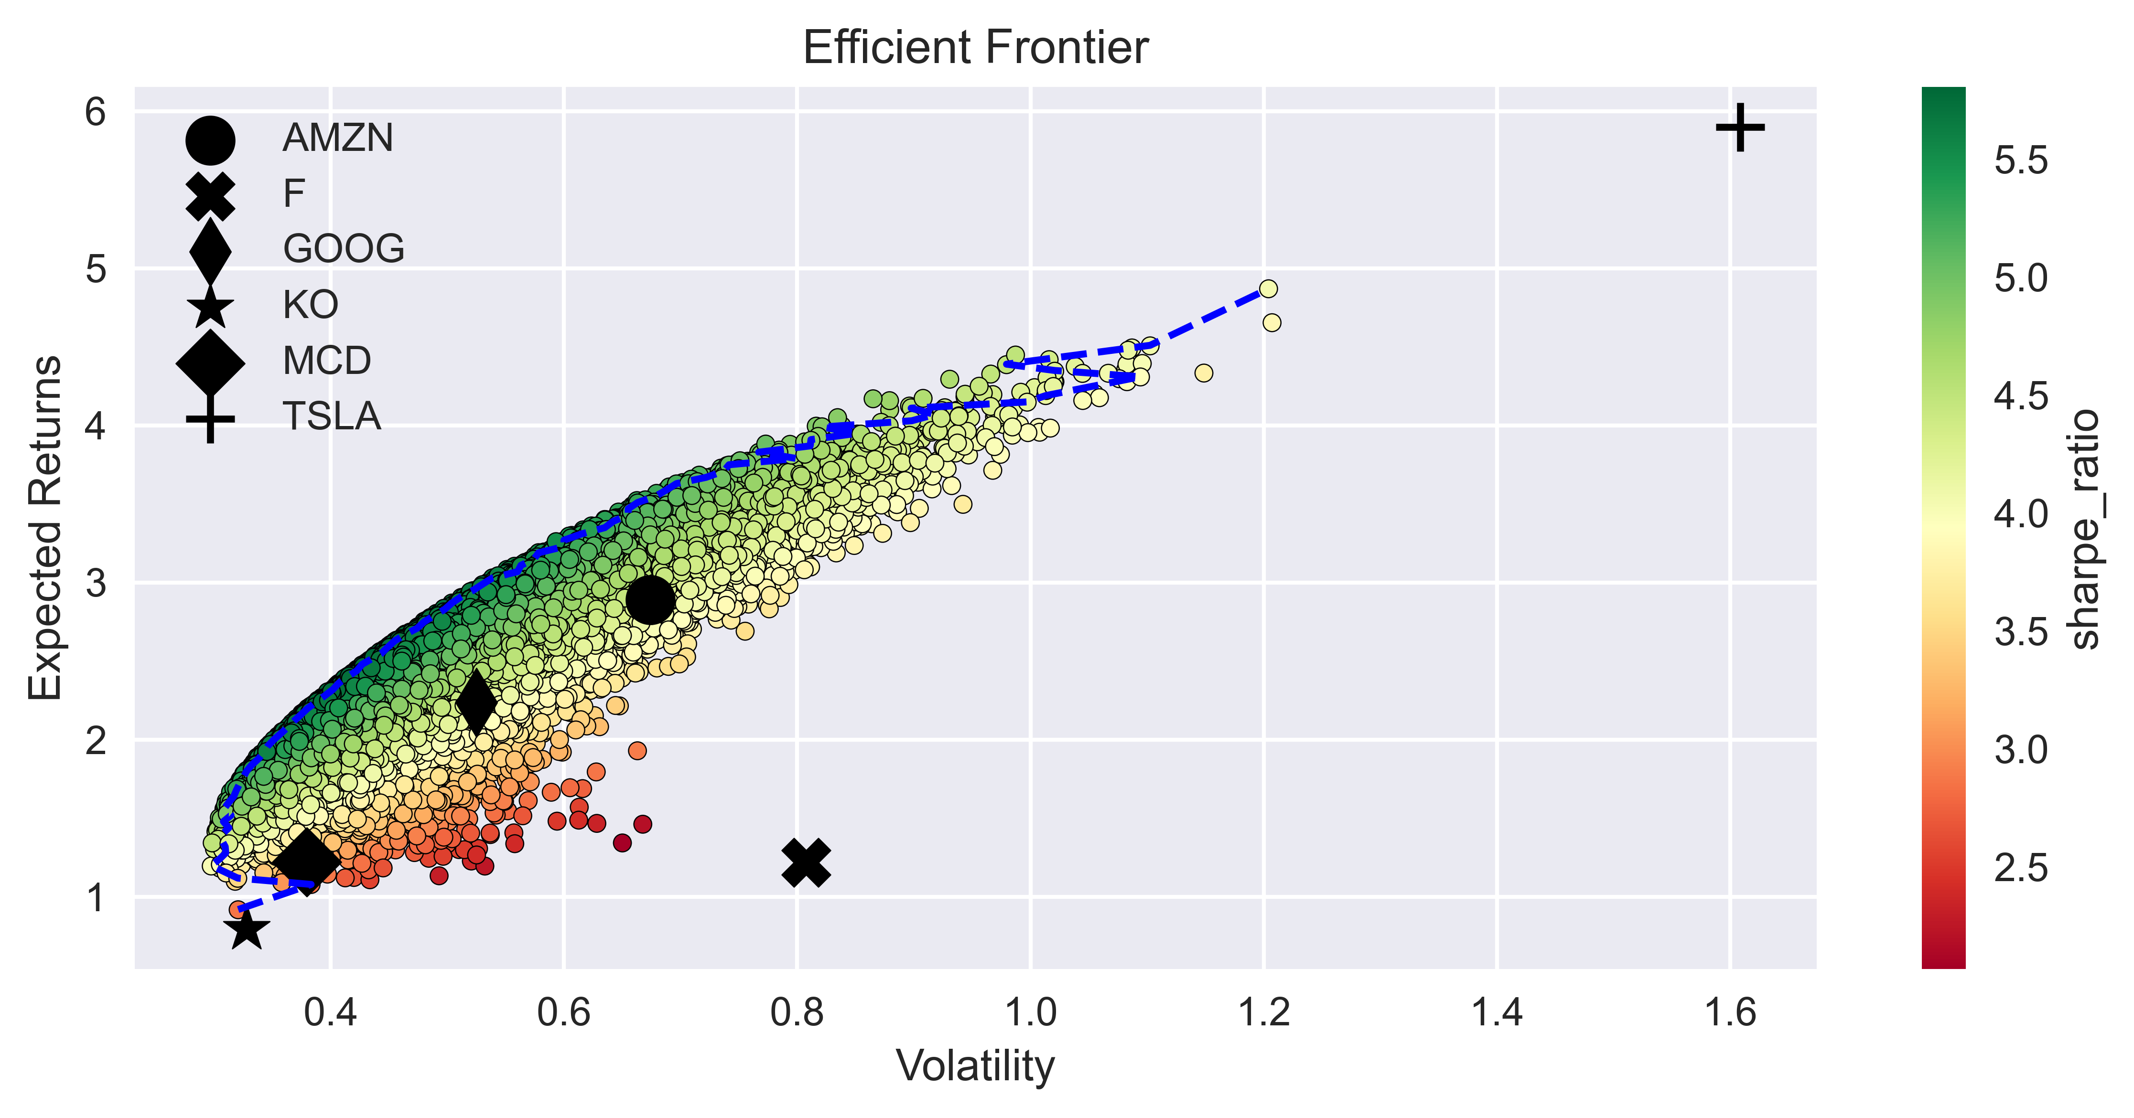
6. COSTRUZIONE DI PORTAFOGLIO
Minimum Volatility portfolio Performance returns: 119.70% volatility: 29.76% sharpe_ratio: 402.21% Weights AMZN: 11.00% F: 2.19% GOOG: 4.87% KO: 73.21% MCD: 7.58% TSLA: 1.15%
Maximum Sharpe Ratio portfolio Performance returns: 239.15% volatility: 41.19% sharpe_ratio: 580.59% Weights AMZN: 28.27% F: 0.32% GOOG: 23.79% KO: 8.70% MCD: 28.36% TSLA: 10.55%

Slide 22
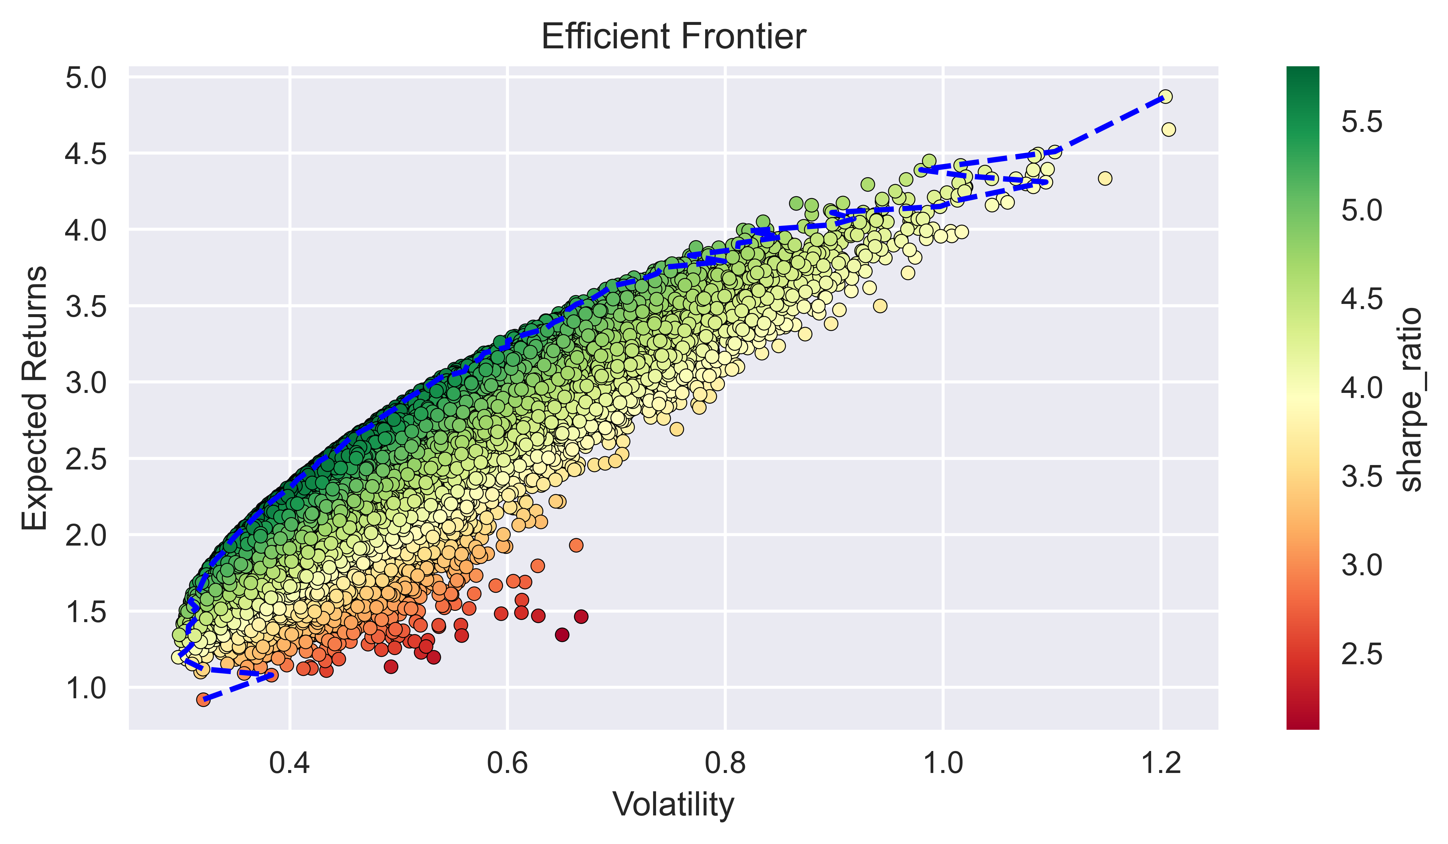
Scipy
Minimum Volatility portfolio Performance Return: 15.45% Volatility: 32.77%
Sharpe Ratio: 47.14% Weights AMZN: 0.00% F: 0.00% GOOG: 0.00% KO: 100.00%
MCD: 0.00% TSLA: 0.00%
Maximum Sharpe Ratio portfolio​
Performance​
Return: 238.39% Volatility: 41.01% ​
Sharpe Ratio: 581.26% ​
Weights AMZN: 28.16% F: 0.00% GOOG: 22.41% KO: 11.80% MCD: 26.61% TSLA: 11.01%

Slide 23


Monte Carlo

Slide 24
PORTAFOGLIO
METODO ANALITICO
METODO DI MONTE CARLO
PORTAFOGLIO EFFETTIVO
Pesi
AMZN: 28.16% F: 0.0%
GOOG: 22.41% KO:11.80%
MCD: 26.61% TSLA: 11.01%
Pesi
AMZN: 30.63% F: 2.38%
GOOG: 26.53% KO: 0.34% MCD: 22.92% TSLA: 17.19%
Pesi
AMZN: 16.67% F: 16.67%
GOOG: 16.67% KO: 16.67%
MCD: 16.67% TSLA: 16.67%
Beta of optimized portofolio with Scipy compared to market is 0.9181
Beta of optimized portfolio with monte carlo compared to the market is 0.9242
Rendimento del portafoglio con Scipy
Expected return: 0.0219
Rendimento del portafoglio con Monte Carlo
Expected return: 0.0219
Rendimento del portafoglio Effettivo (tutti pesi uguali)
Expected return: 0.0218

